Slide 1
Kafka for .NET Developers
Ian Cooper
X/Hachyderm: ICooper

Slide 2
Who are you?
Software Developer for more than 25 years
Stuff I care about: Messaging, EDA, Microservices, TDD, XP, OO, RDD & DDD, Code that Fits in My Head, C#
Places I have worked: DTI, Reuters, Sungard, Beazley, Huddle, Just Eat Takeaway
No smart folks
Just the folks in this room

Slide 3
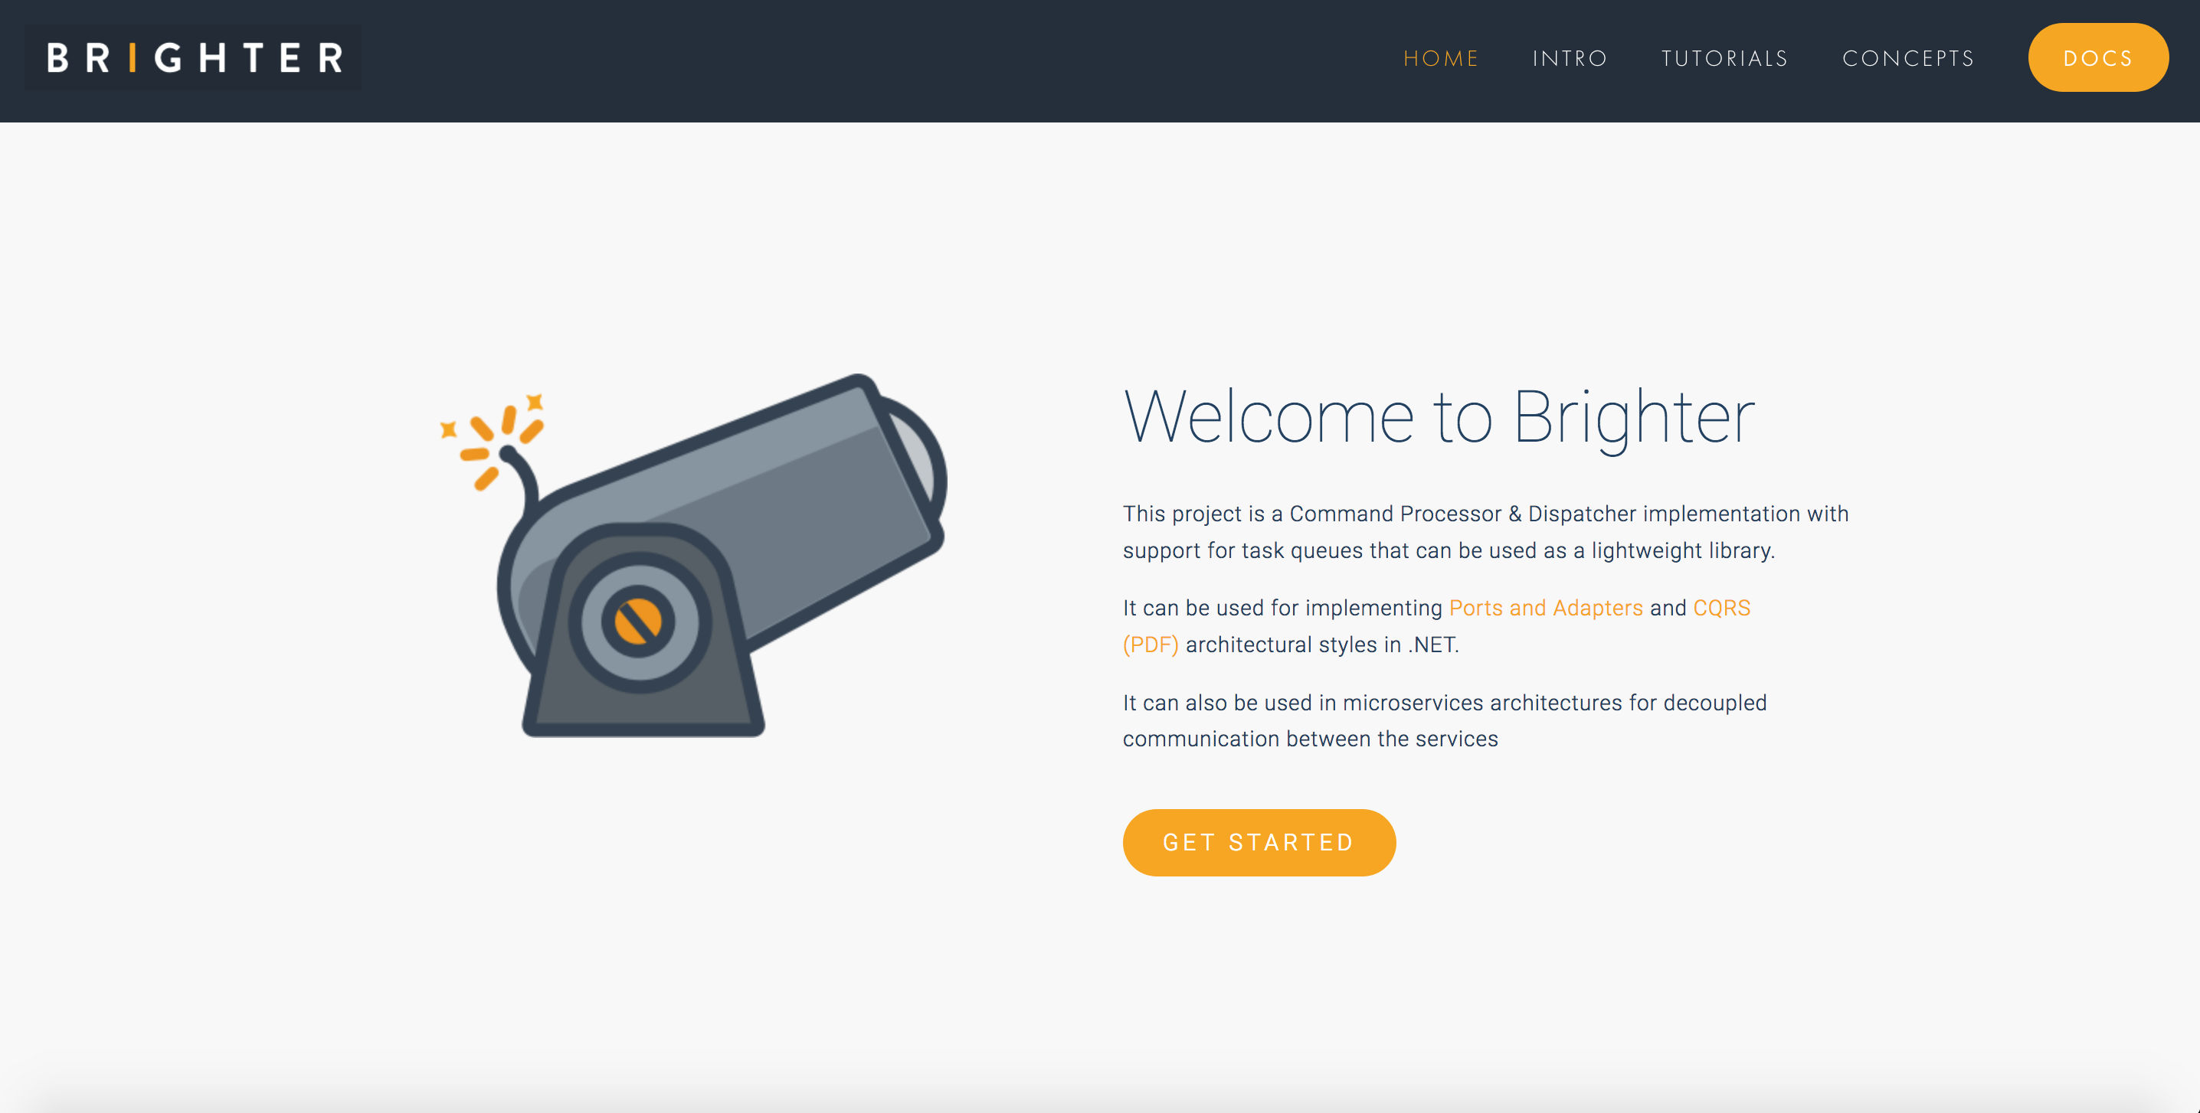

Slide 4
Agenda
Kafka
Kafka and C#
Under the Hood
Reliable Producer
Reliable Consumer
Serializers, De-serializers & Schema Registry

Slide 5
Agenda
Kafka
Kafka and C#
Under the Hood
Reliable Producer
Reliable Consumer
Serializers, De-serializers & Schema Registry

Slide 6
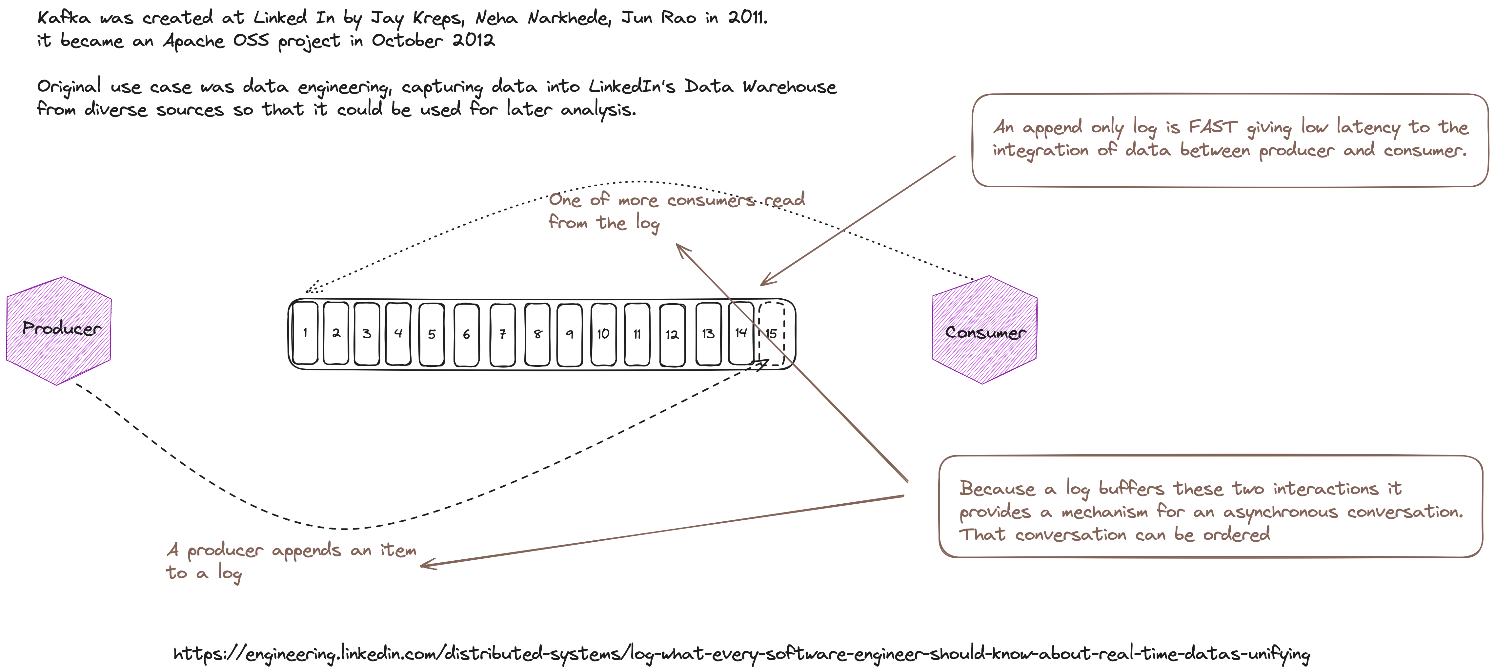
Notes:
A buffer – the log – between producer and consumer – allows Kafka to support an asynchronous conversation (both parties do not need to be present due to store and forward) i.e. messaging

Slide 7
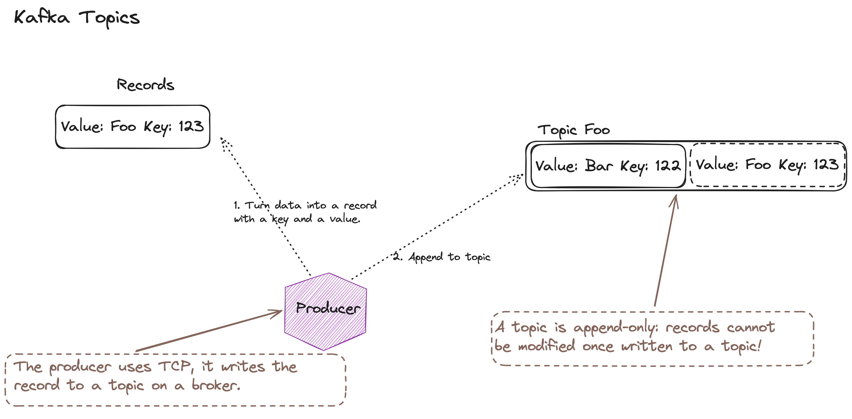
Notes:
The topic is what messaging calls a “channel” a virtual pipe, addressable by a name. Both sides need to agree the channel name.

Slide 8
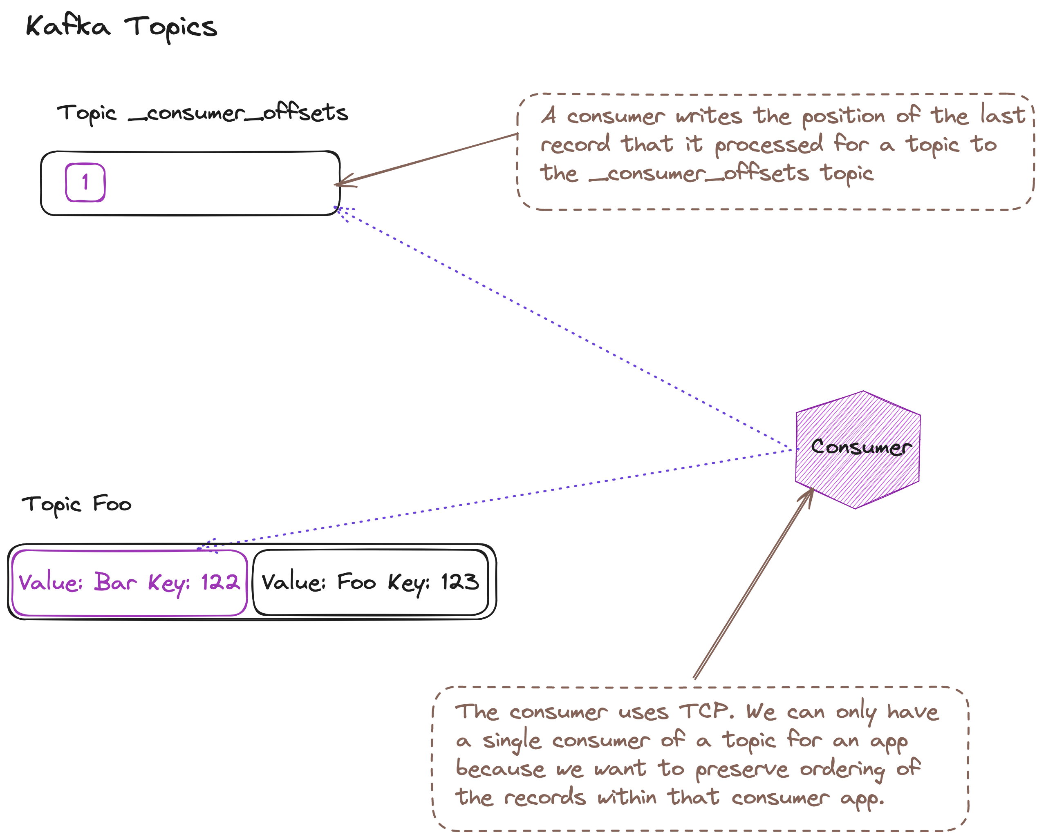
Notes:
A consumer’s read is non-destructive, unlike a queueing system, we don’t delete the item, we simply move our index for what we have seen. This means many consumers can read the same topic, maintaining their own offset into what they have read.
Given that a consumer maintains it’s own index, then how do we read a topic faster? If we simply add more consumers, each new consumer will start reading at the beginning of the topic. If we have consumers share the same offset then they will loose ordering

Slide 9
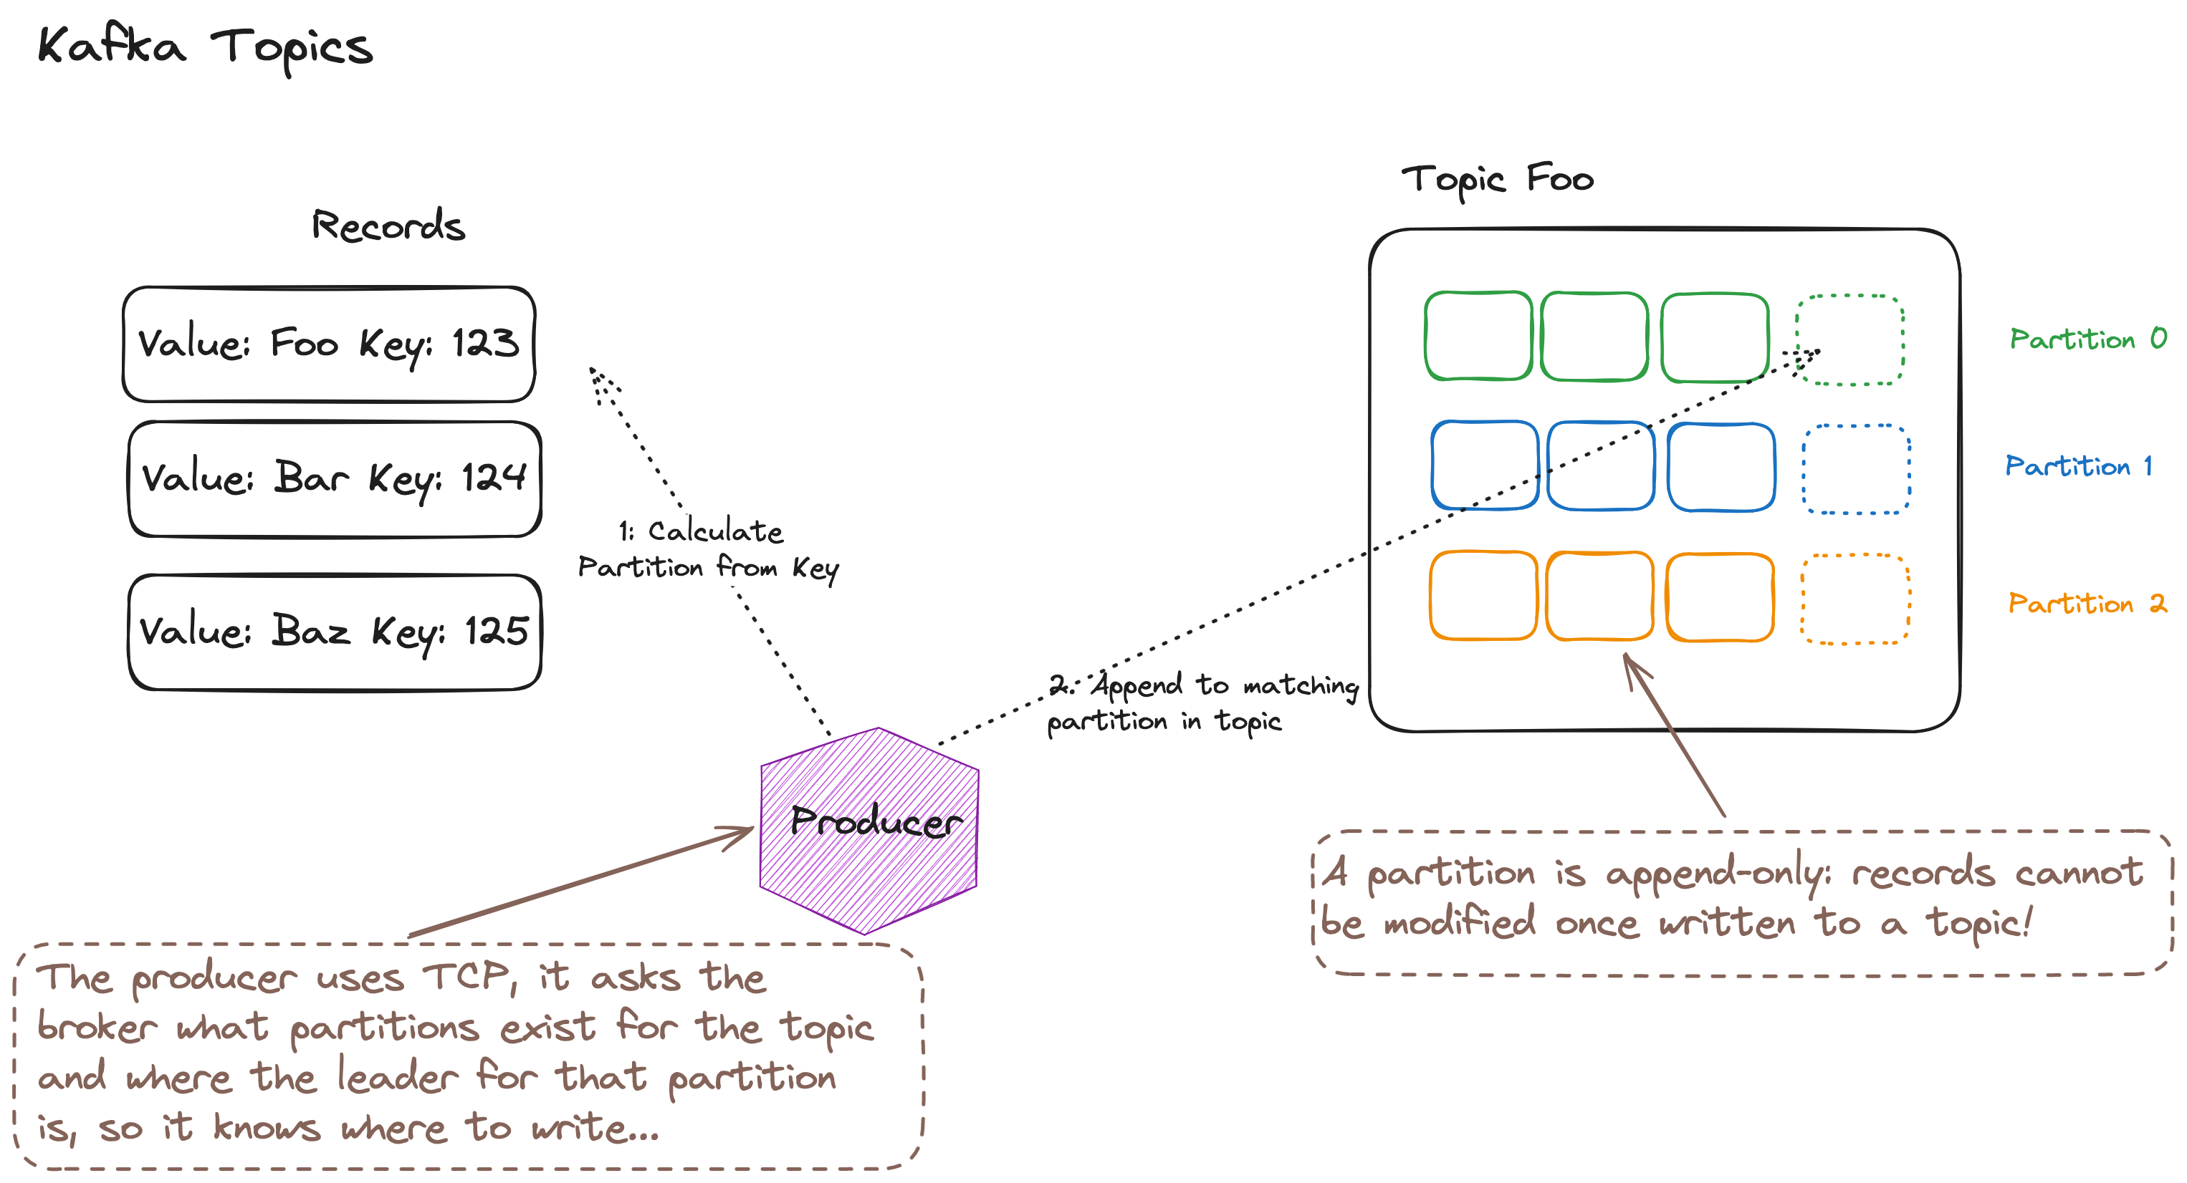
Notes:
To scale we need to partition the topic, so that consumers can read a partition on the topic instead of the topic. When a producer writes it writes to the leader for a partition. The partition is determined by an algorithm. We could just randomly assign, to balance across our partitions, but if we want to support reading all of the data for a particular key in order, such as subsequent changes to an order, or customer record, we need anything with the same key to go to the same partition, for this we commonly use consistent hashing

Slide 10
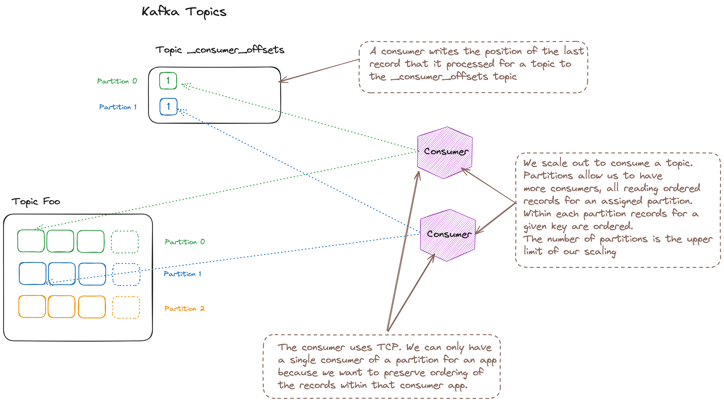
Notes:
A consumer reads from a partition, and records offsets into that partition. This allows us to scale out, we can usefully have as many consumers as partitions.
How do you know how many partitions you want? Queueing theory. In essence rate of consumption must exceed rate of arrival to avoid a queue backing up. If it takes Xms to process and work arrives every Yms then Y/X >= 1

Slide 11
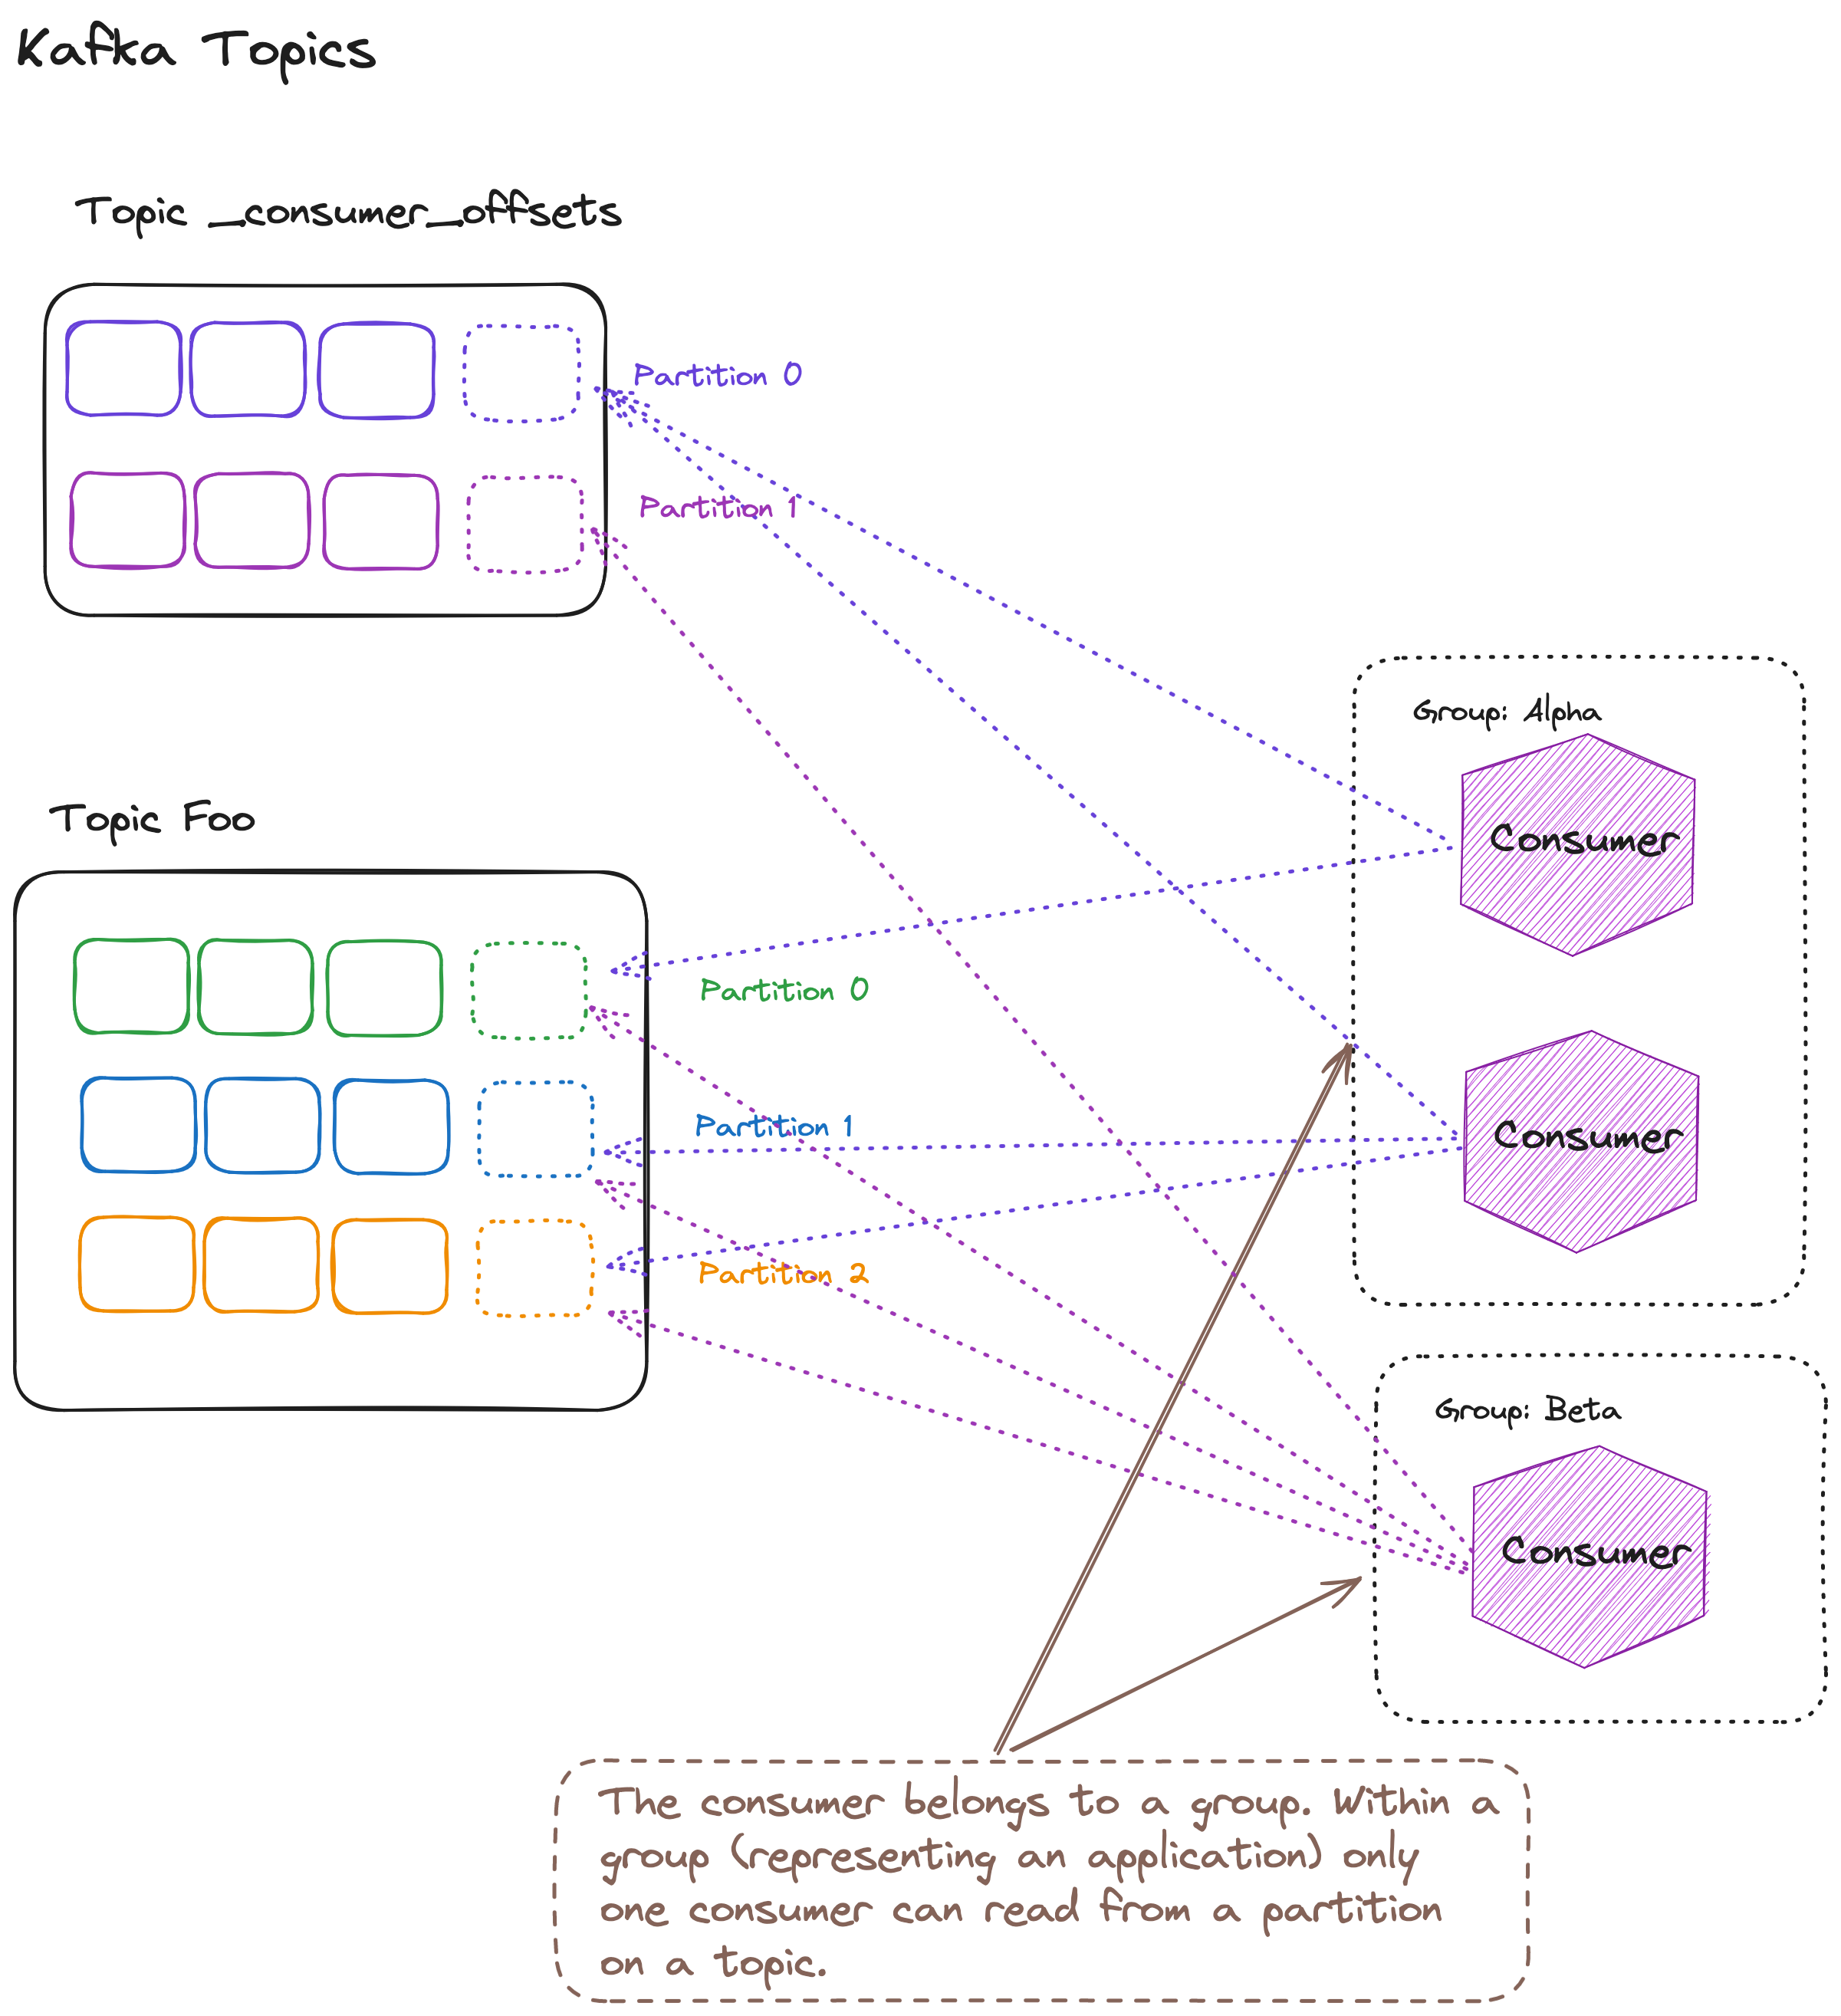
Notes:
Now a given application wants to read all of a topic, regardless of how many consumers are running. Kafka supports the notion of a consumer group, which allow you to ensure that all the partitions for a topic will be read, with each partition being assigned at most one reader (so as to preserve ordering); a consumer may be assigned multiple partitions if there are more partitions than consumers (this may be useful if you want to scale down outside of peak).

Slide 12
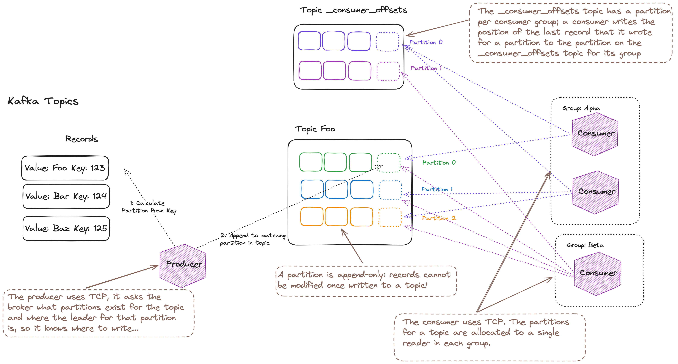
Notes:
An overall picture of how Kafka works

Slide 13
Agenda
T:10
Kafka
Kafka and C#
Under the Hood
Reliable Producer
Reliable Consumer
Serializers, De-serializers & Schema Registry

Slide 14
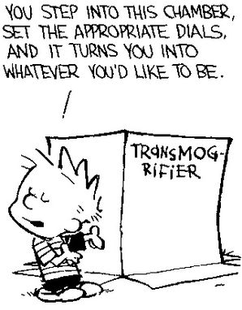
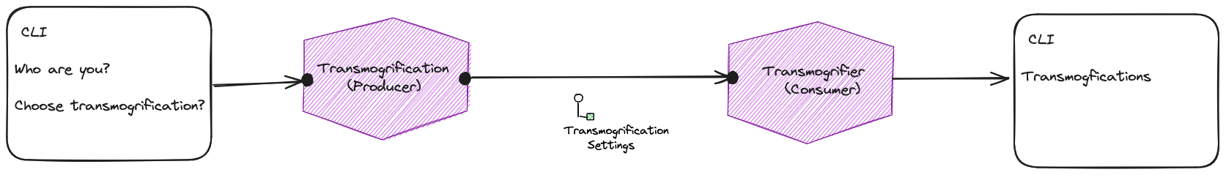
Building a Transmogrifier
Calvin and Hobbes – Bill Watterson

Slide 15

Building a Transmogrifier
Tommy og Tigern – Bill Watterson

Slide 16
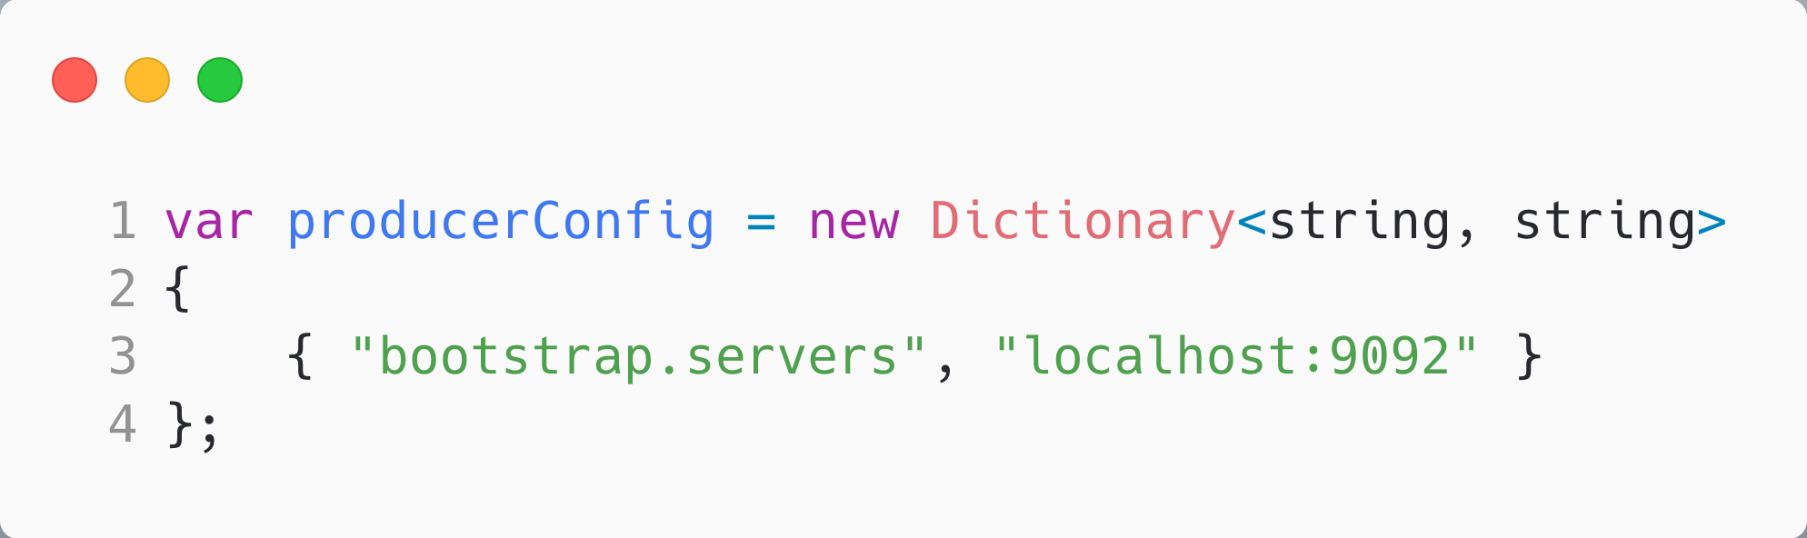
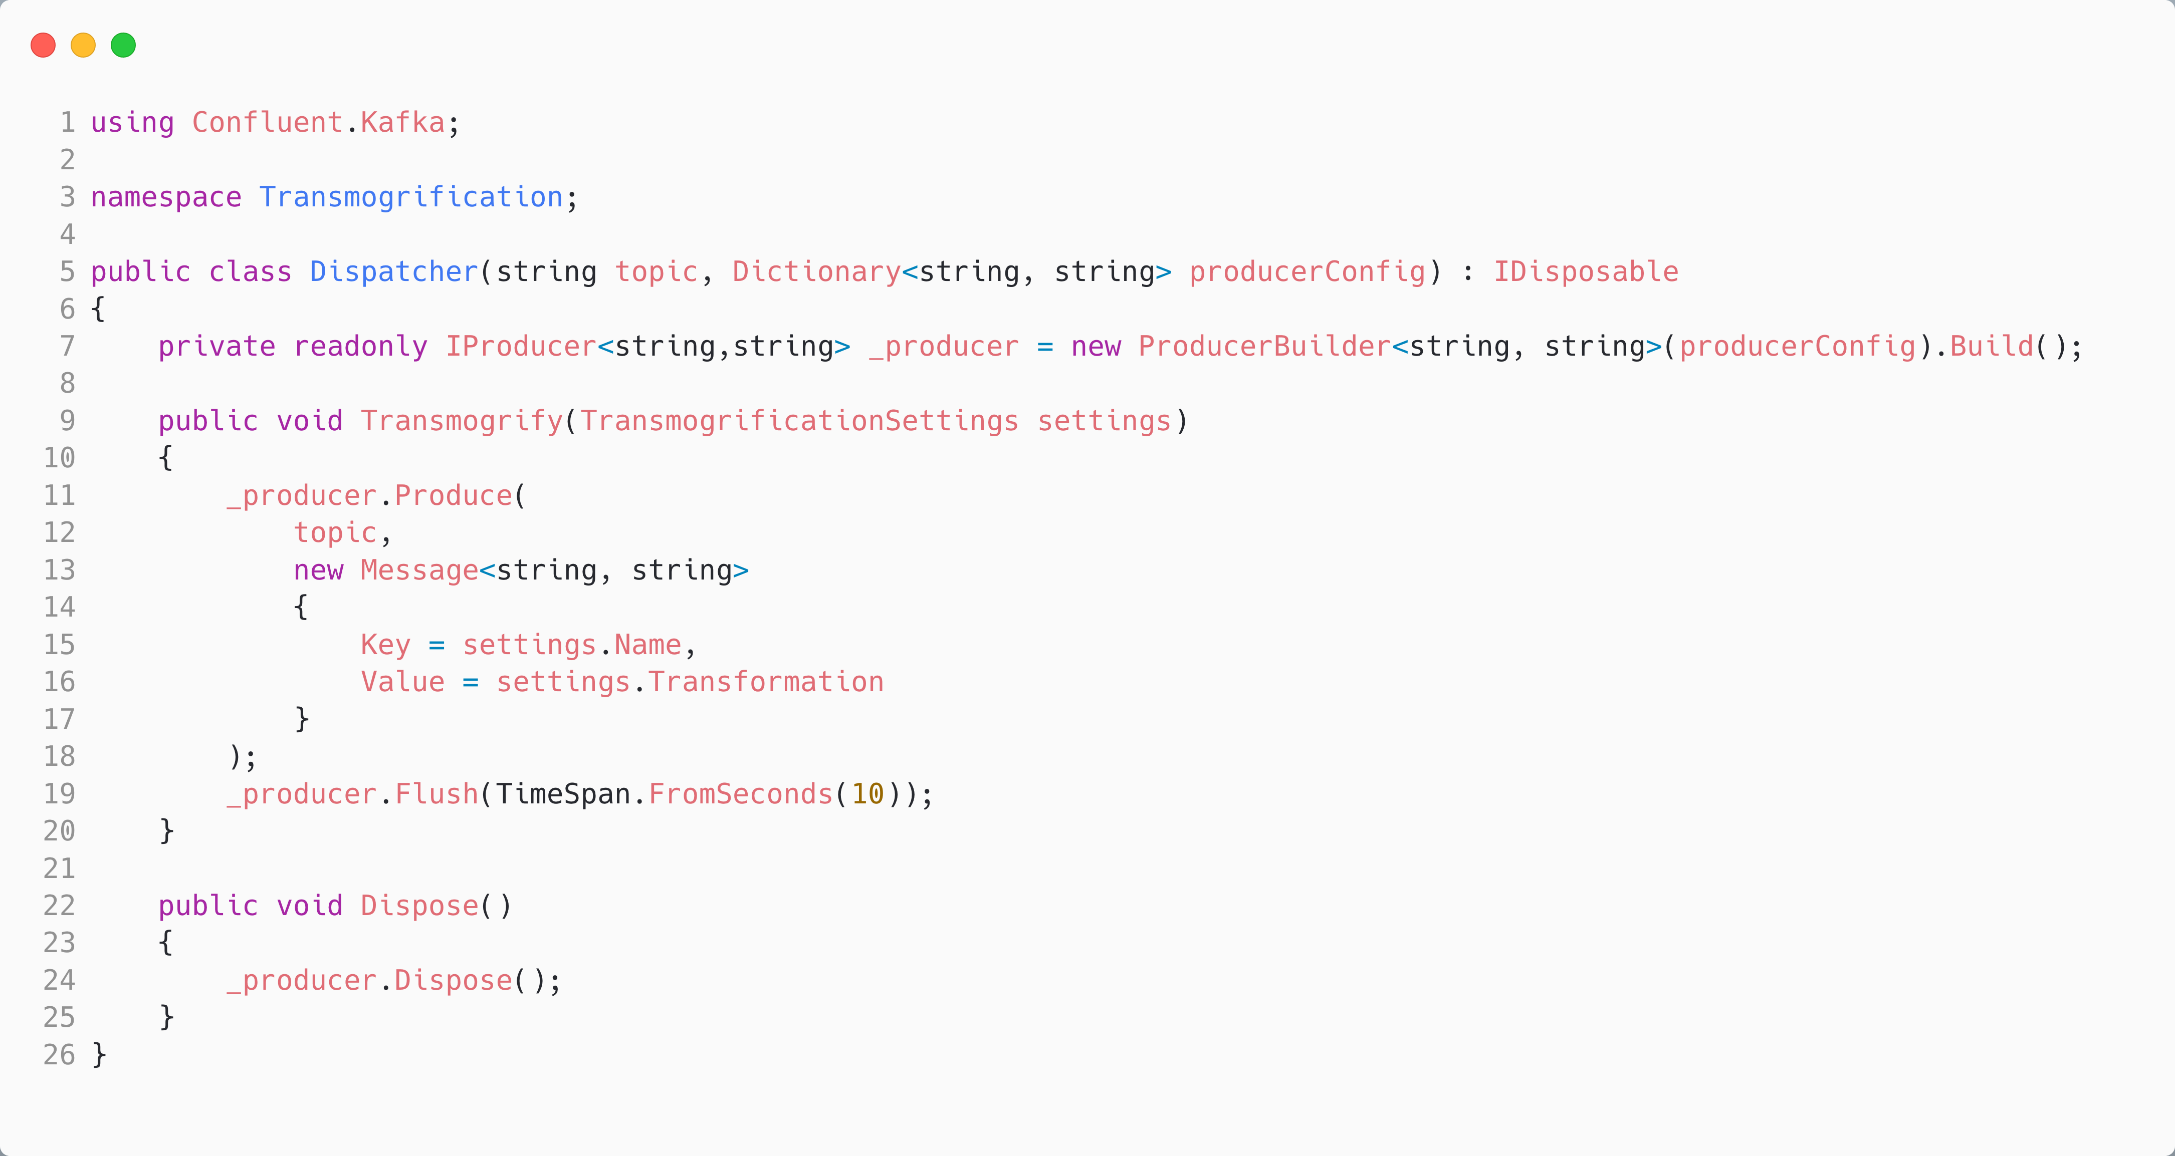
Producing a Message in C#
The topic we want to produce to.
Create a producer from the config; note that ProducerBuilder<string, string> means:
- key: string
- value: string
Tidy.
Produce a message to a topic; build message from our data
Notes:
Note ProducerBuilder<string, string> and MessageBuilder<string, string>. Note that later we will use type safety. Might be interesting to note that Brighter uses <string, byte[]> as we always serialize the body as a byte[]

Slide 17
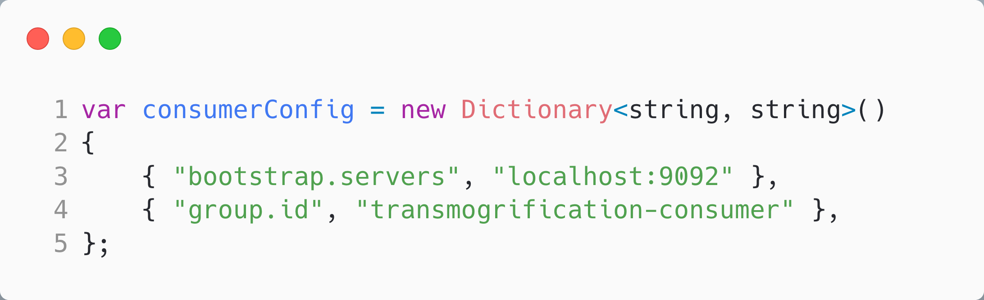
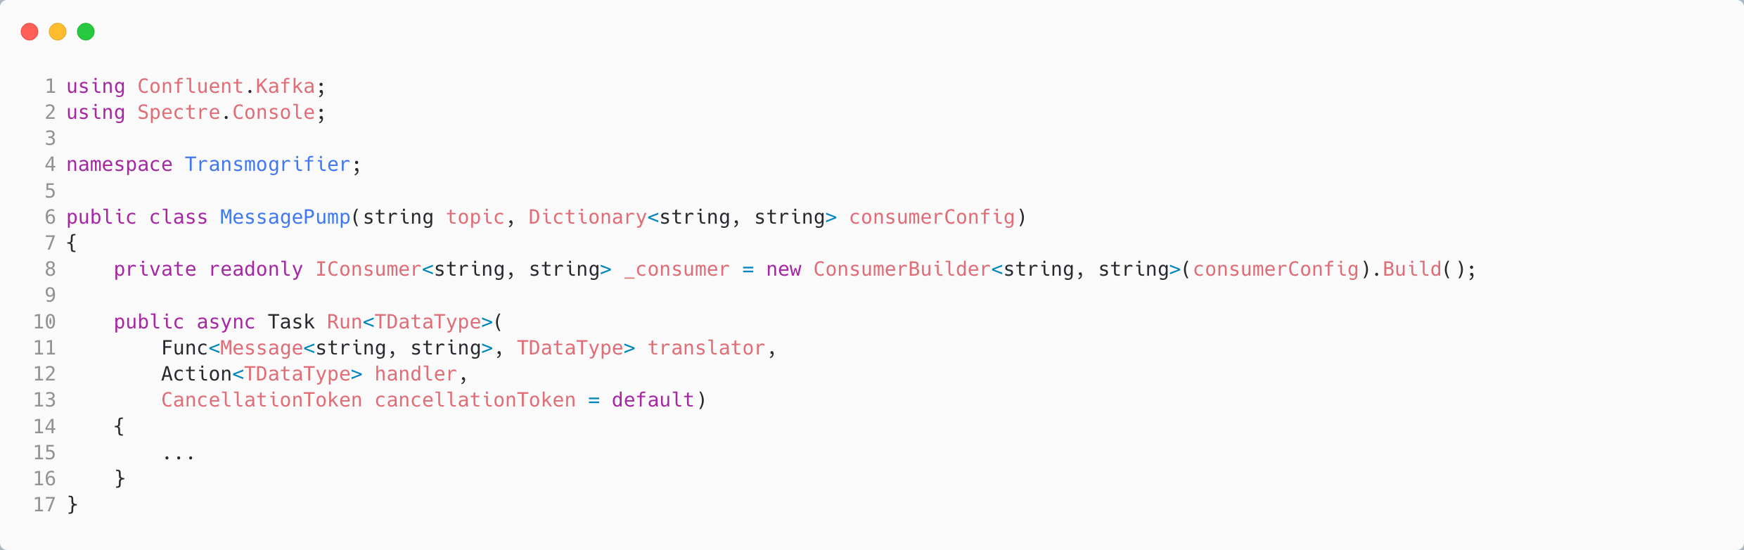
Consuming a Message in C#
The topic we want to consume from.
Create a consumer from the config; note that IConsumer<string, string> means:
- key: string
- value: string
Generic, so pass in:
- translator
- handler

Slide 18
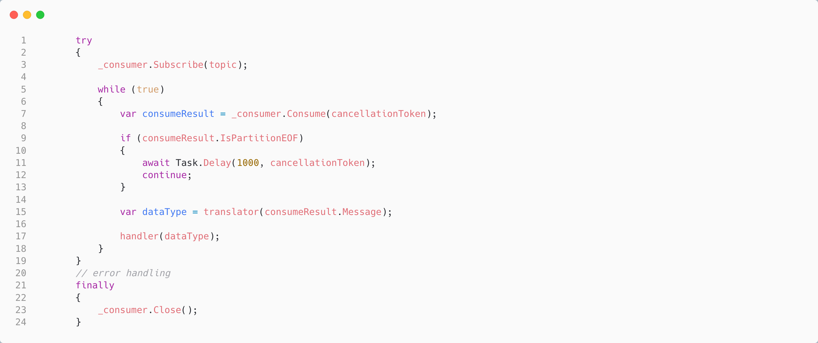
Consuming a Message in C#
Subscribe to topic
Message Pump is an endless loop
Read next result; SDK is buffering for us. Yield if nothing in buffer. Break if cancelled.
Translate the message
Handle the message
Tidy

Slide 19
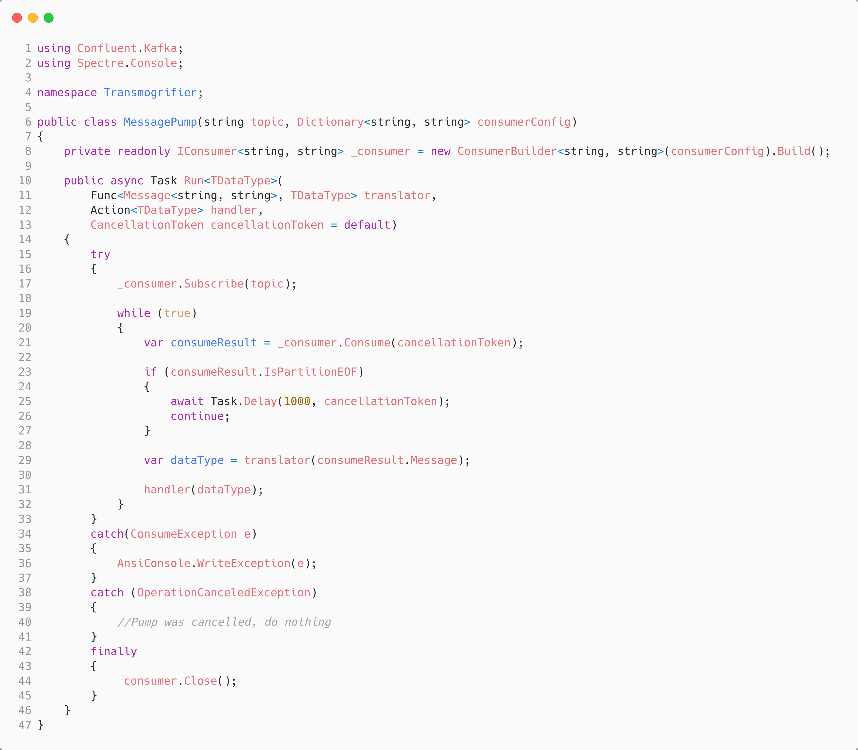
Consuming a Message in C#
The topic we want to consume from.
Generic, so pass in:
- translator
- handler
Subscribe to topic
Create a consumer from the config; note that IConsumer<string, string> means:
- key: string
- value: string
Message Pump is an endless loop
Read next result; SDK is buffering for us. Yield if nothing in buffer. Break if cancelled.
Translate the message
Handle the message
Tidy

Slide 20
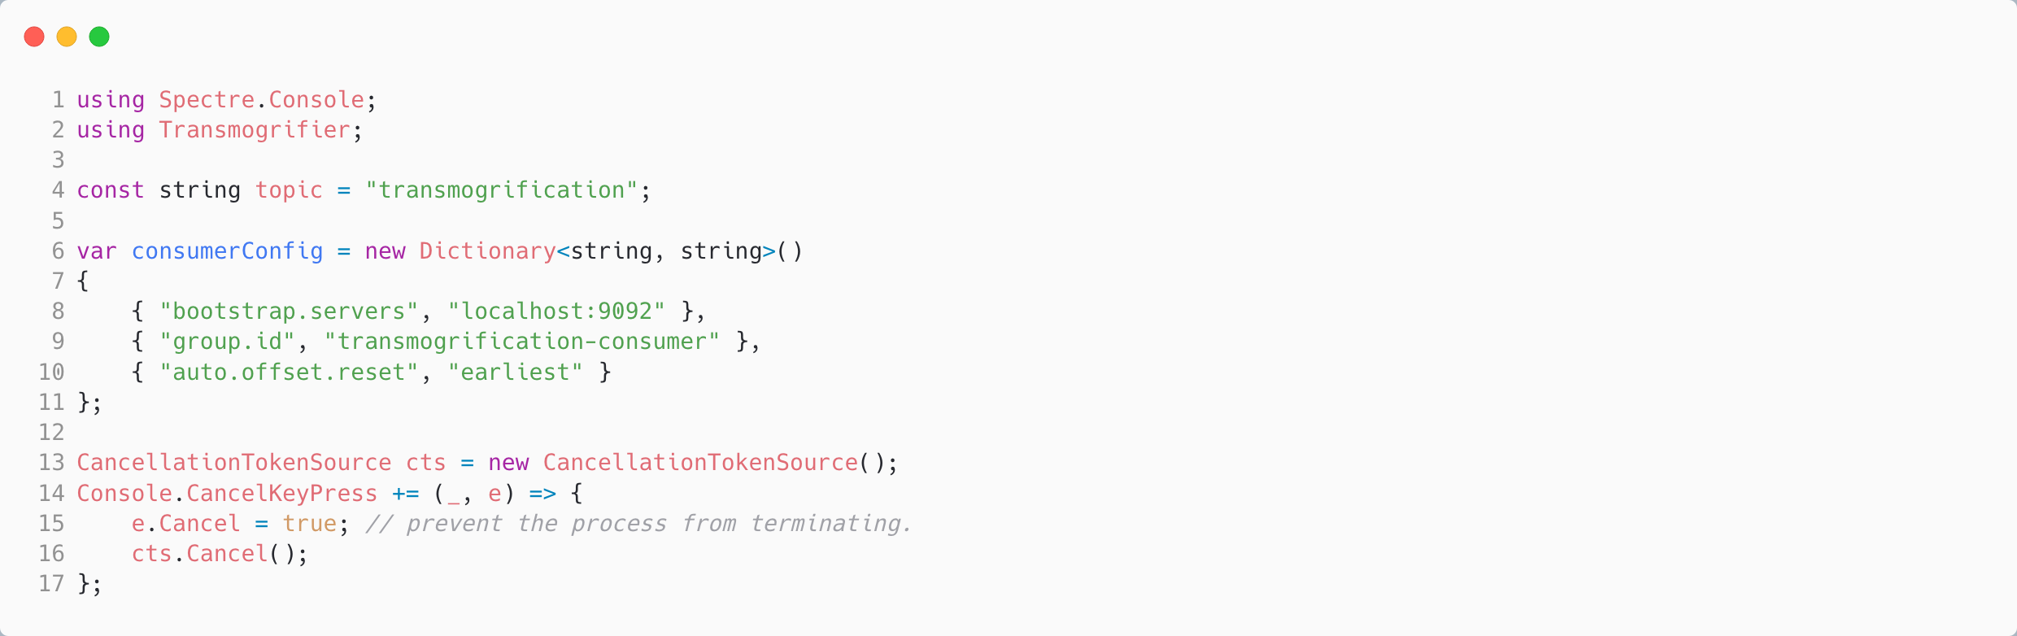
Using the C# Consumer
The topic we want to consume from.
Configure:
- where is Kafka?
- what is our group?

Slide 21
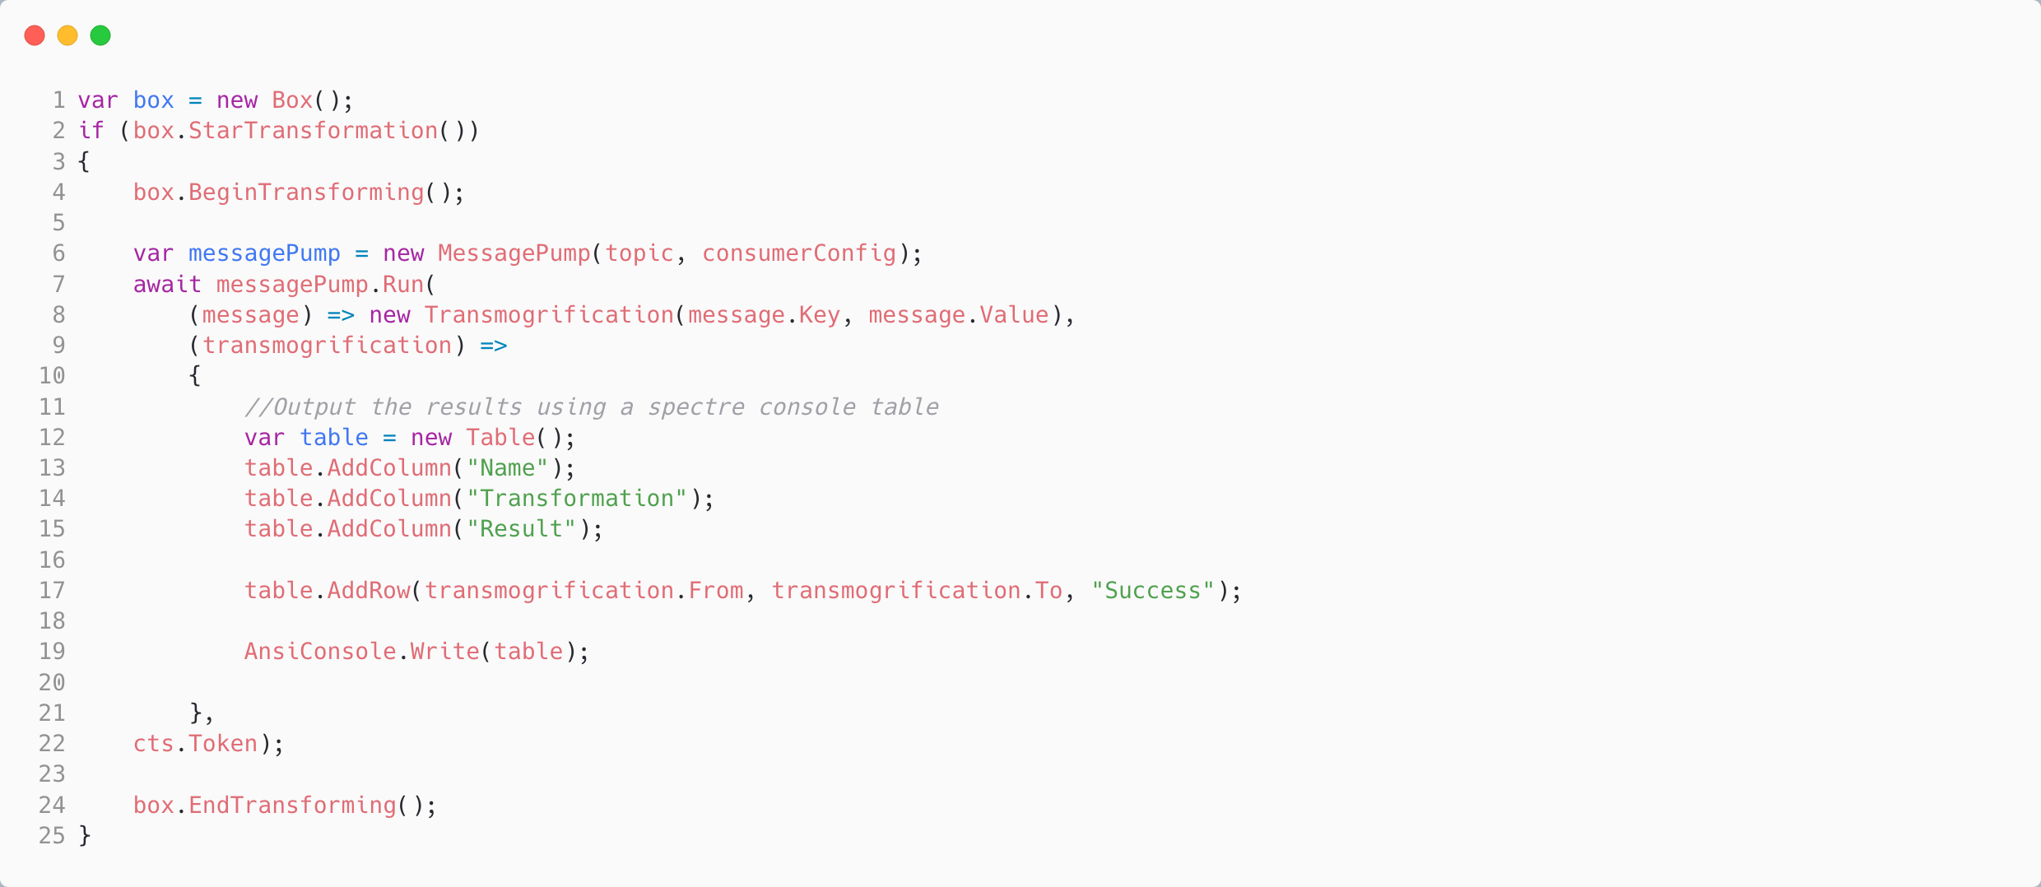
Using the C# Consumer
Translate the message to a data type
Handle the message

Slide 22
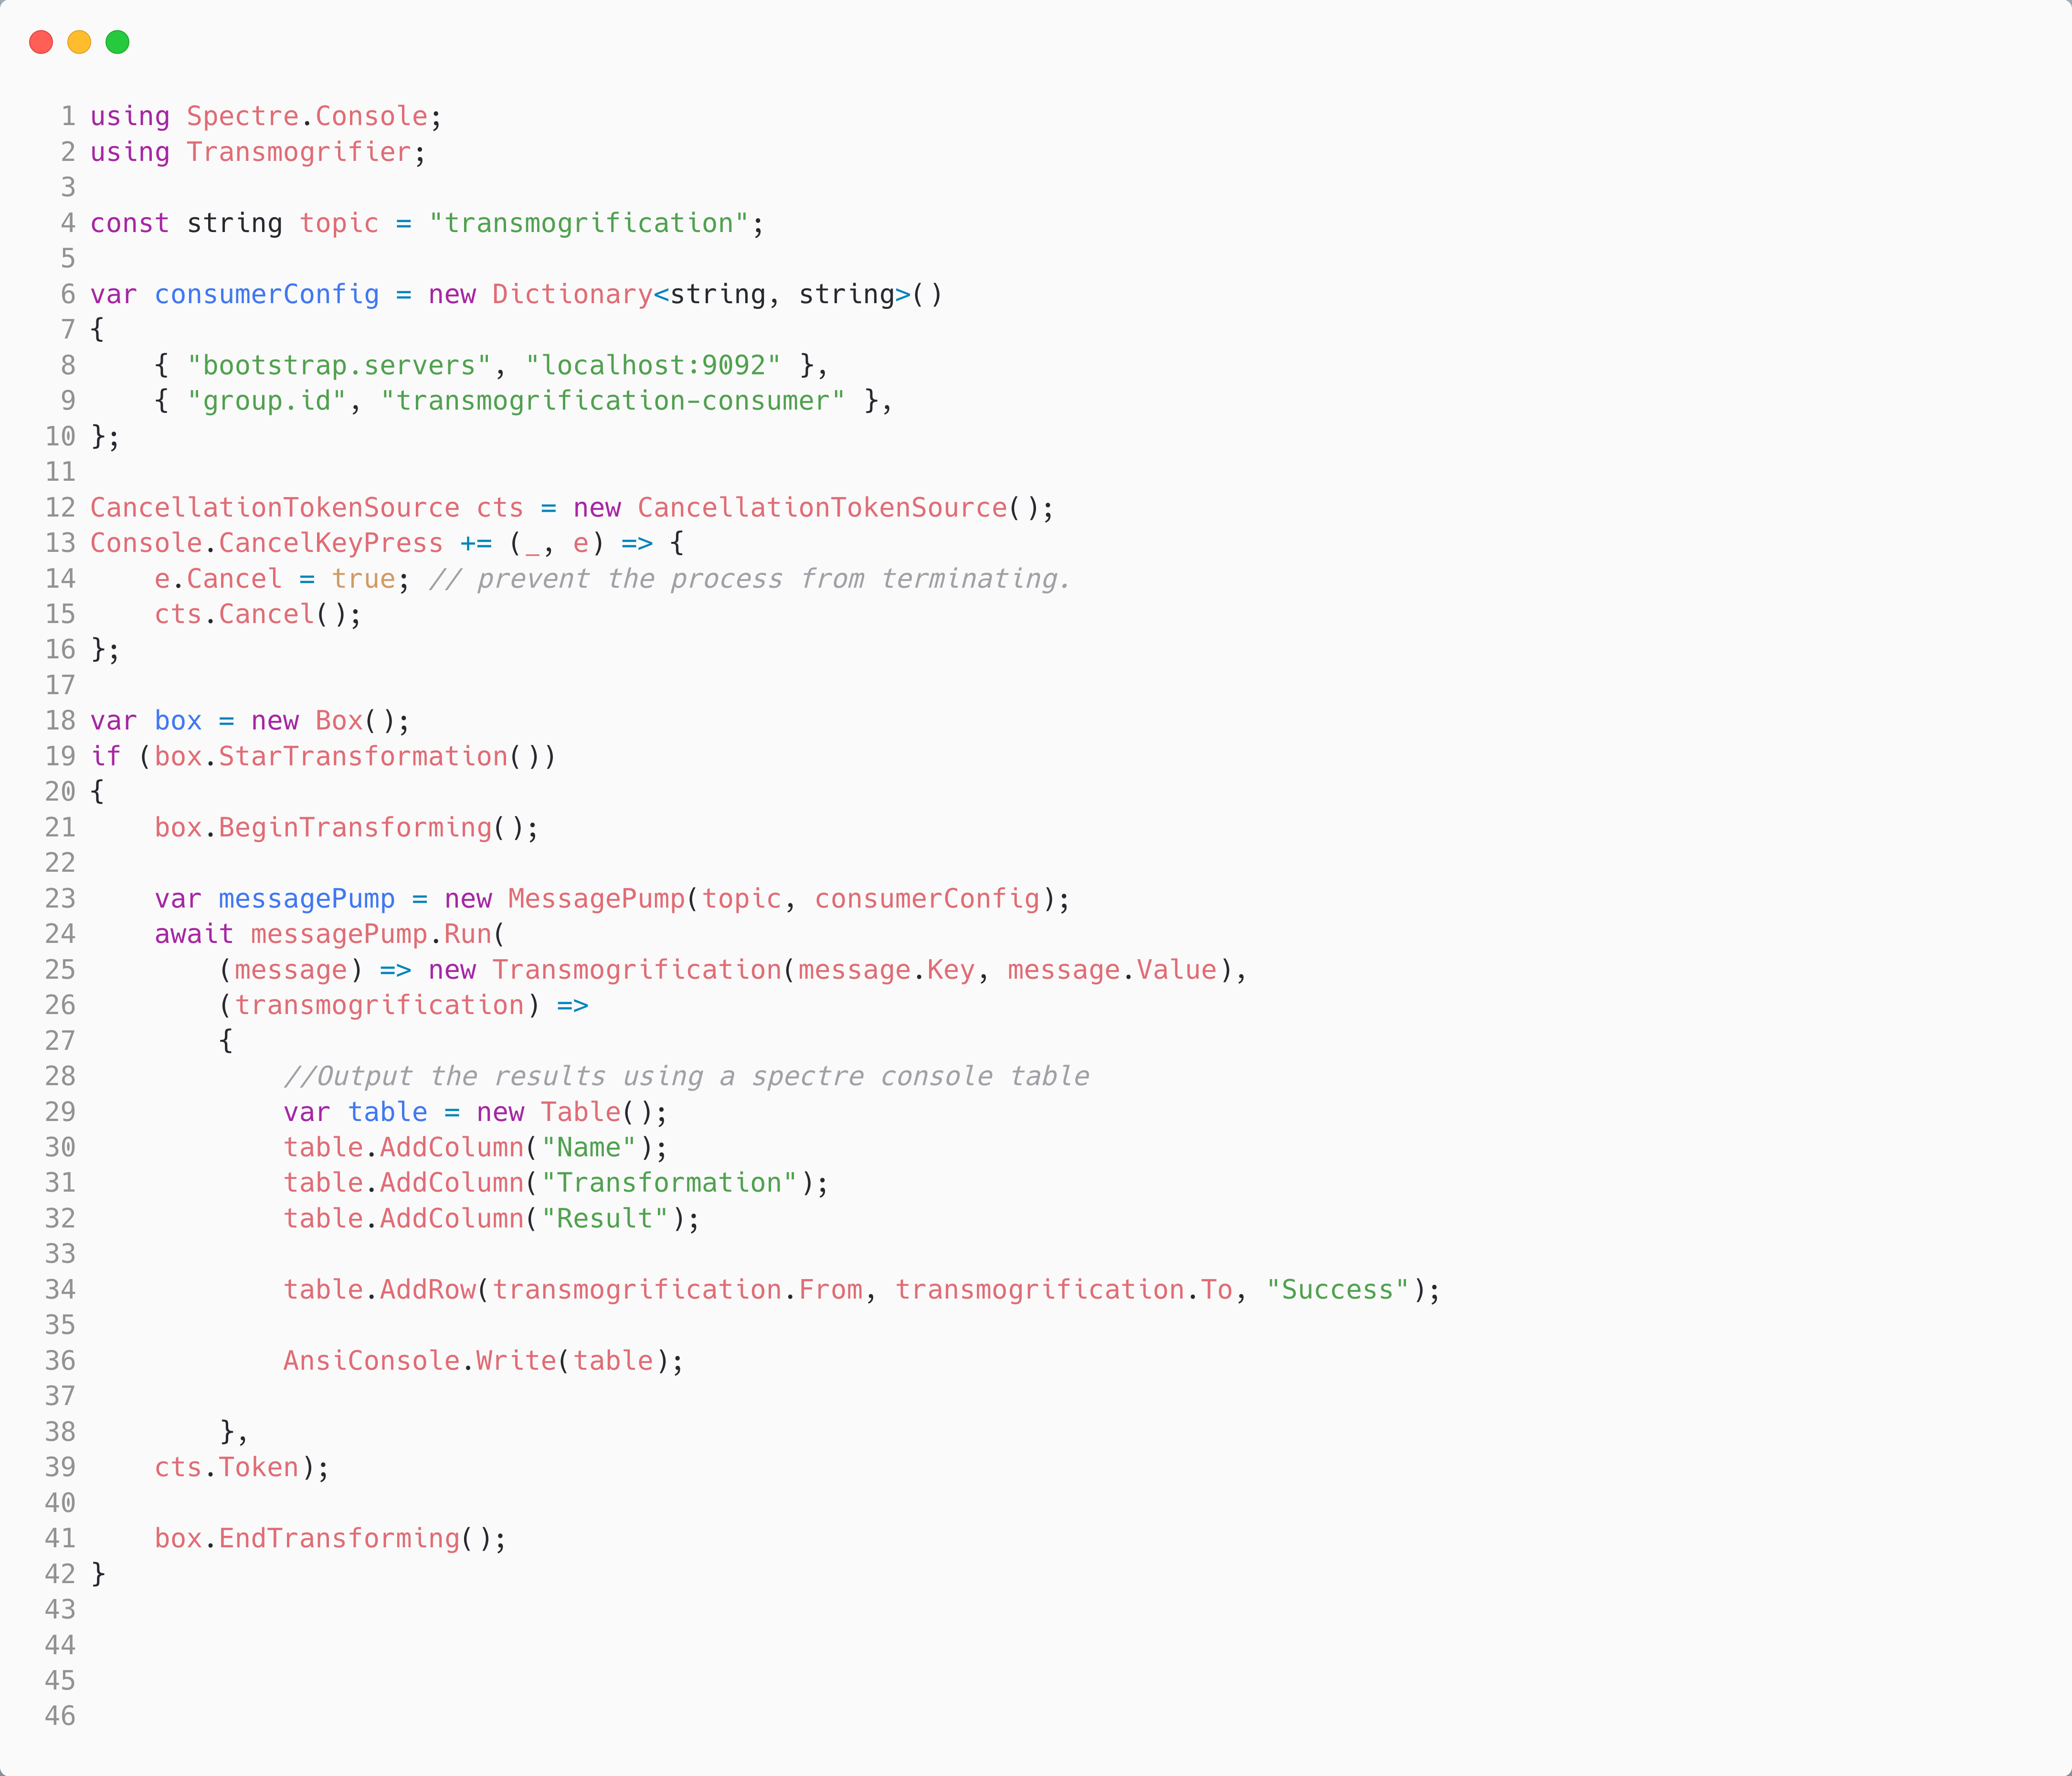
Using the C# Consumer
The topic we want to consume from.
Configure:
- where is Kafka?
- what is our group?
Translate the message to a data type
Handle the data type

Slide 23
Demo Two: Produce and Consume A Message
Calvin and Hobbes – Bill Watterson

Slide 24
Agenda
T:25
Kafka
Kafka and C#
Under the Hood
Reliable Producer
Reliable Consumer
Serializers, De-serializers & Schema Registry

Slide 25
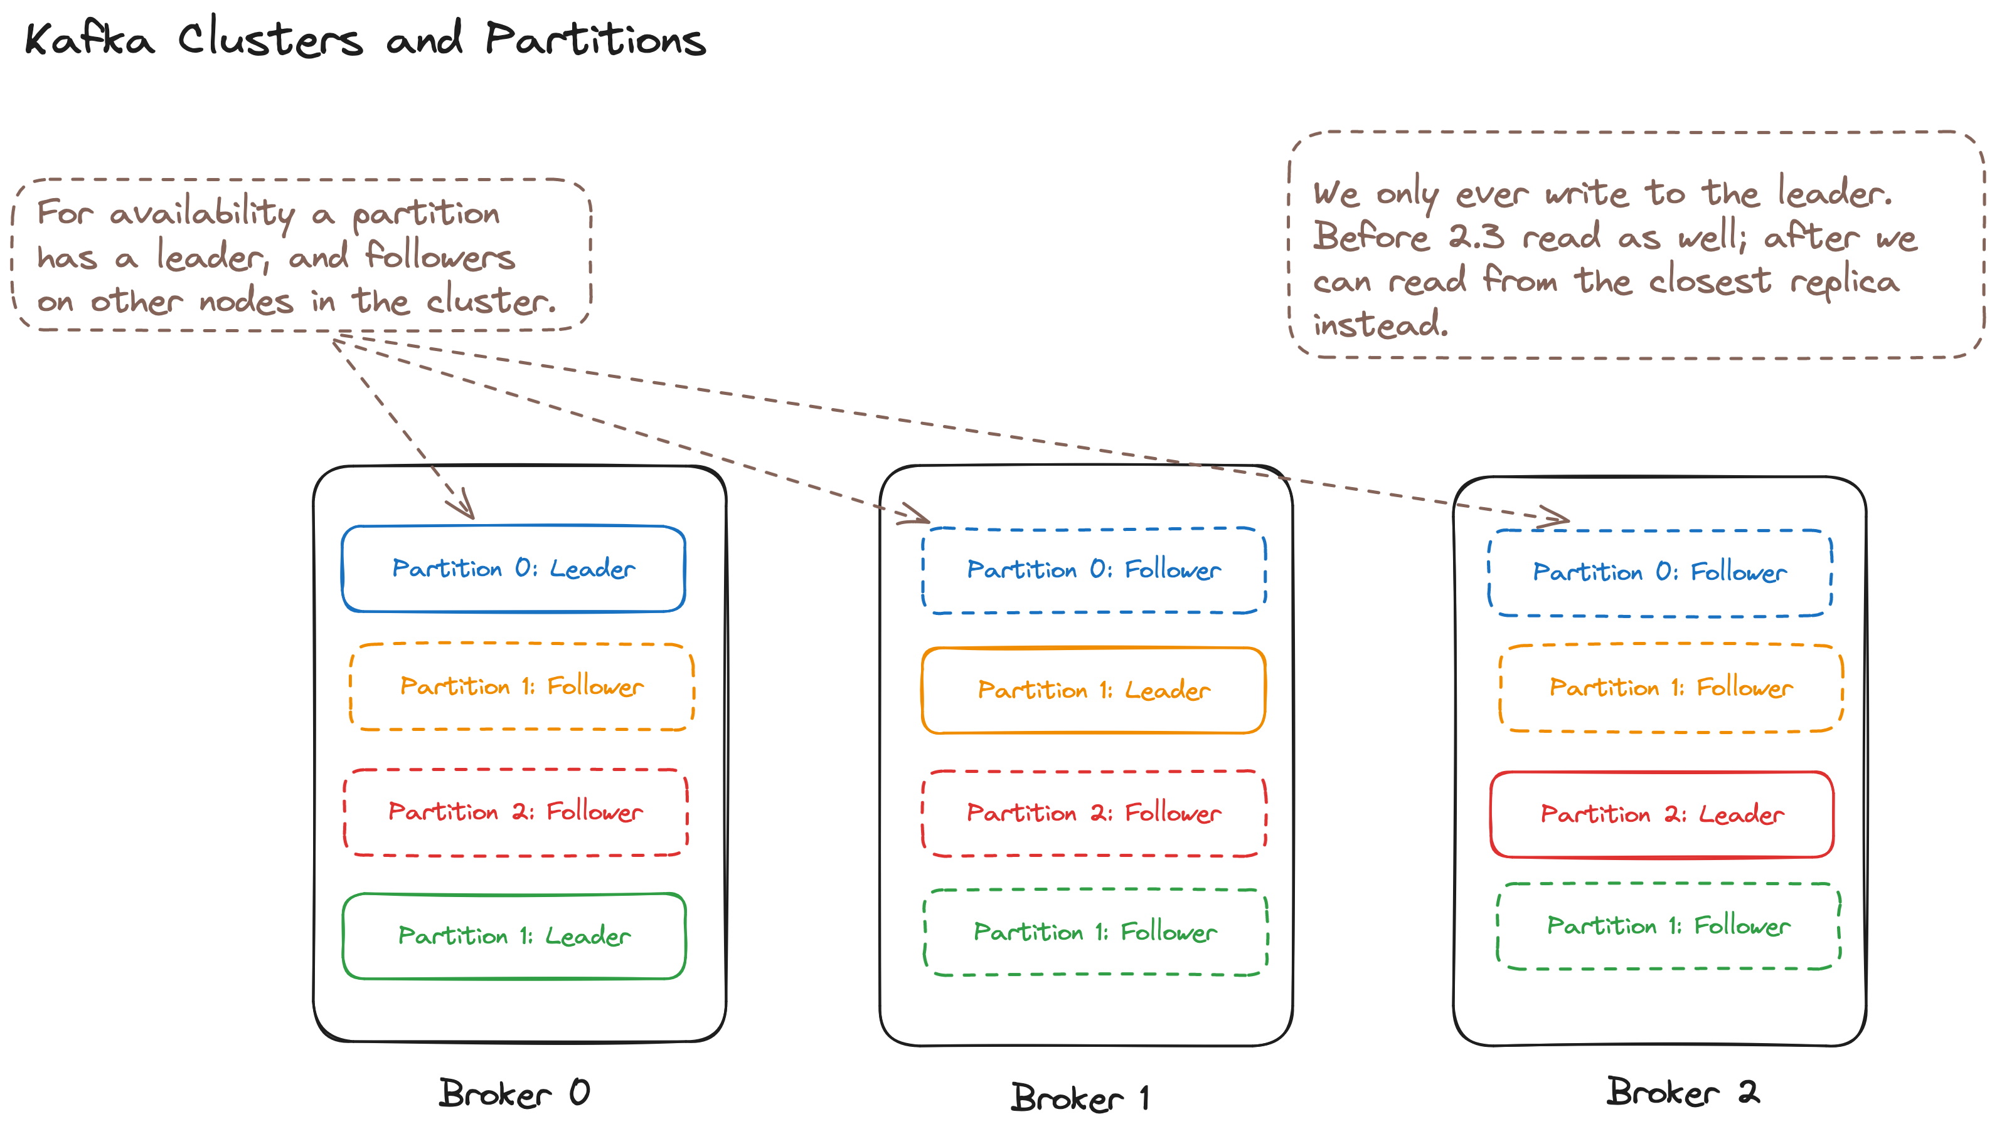

Slide 26
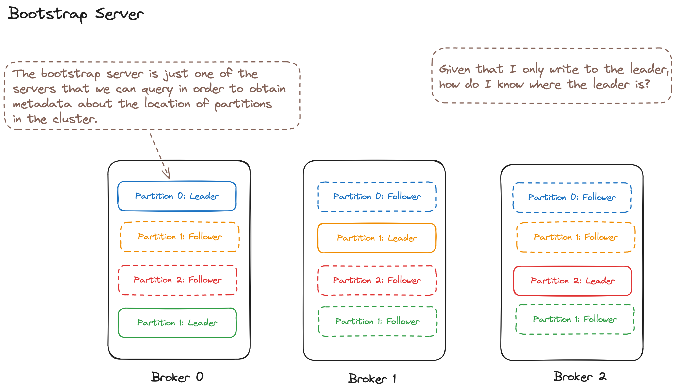

Slide 27
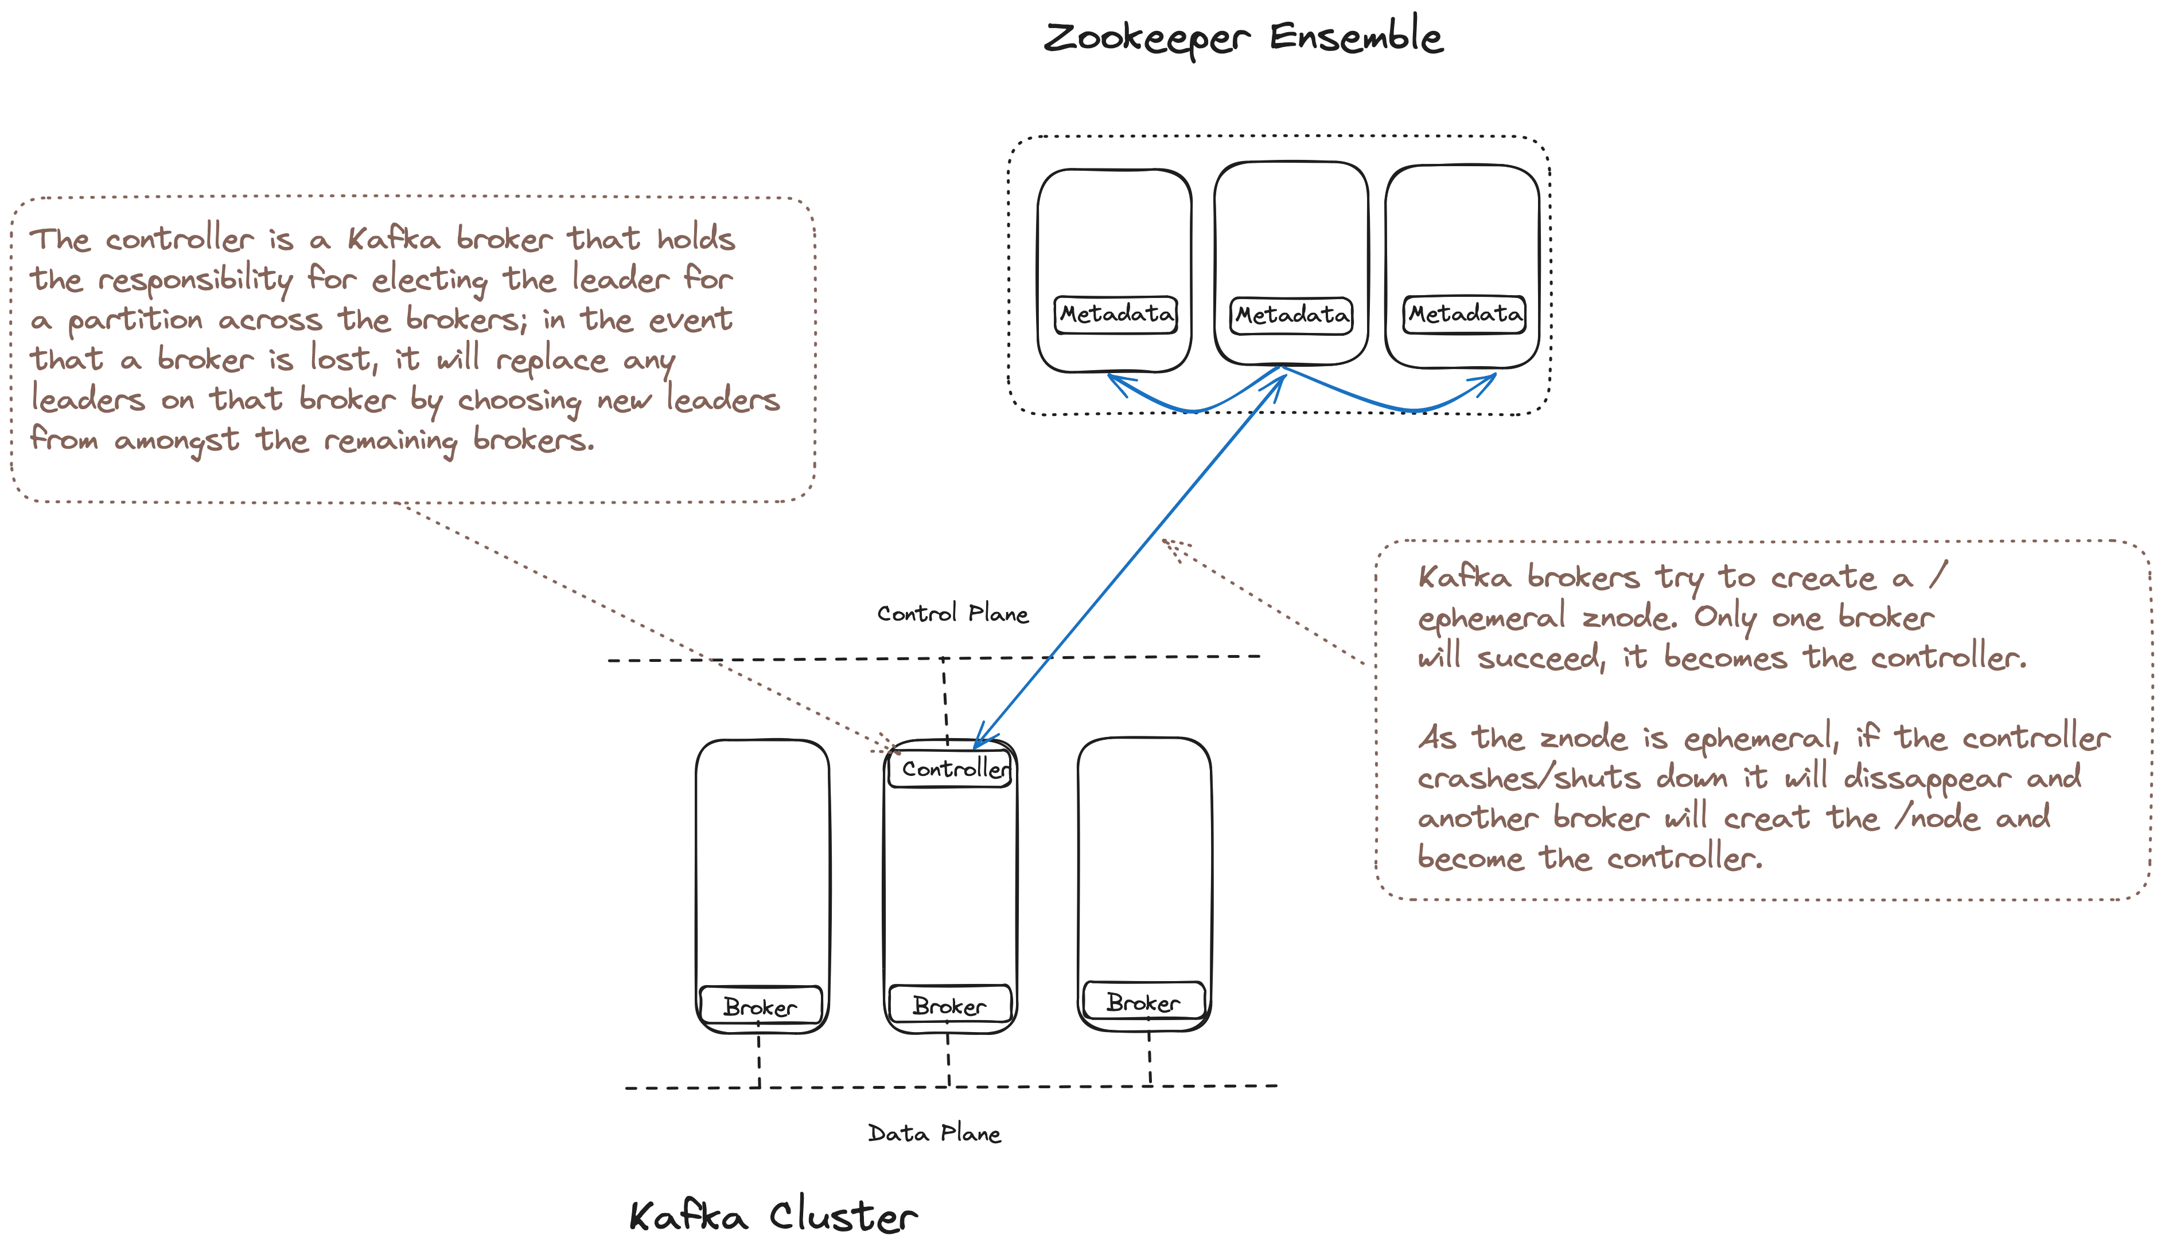

Slide 28
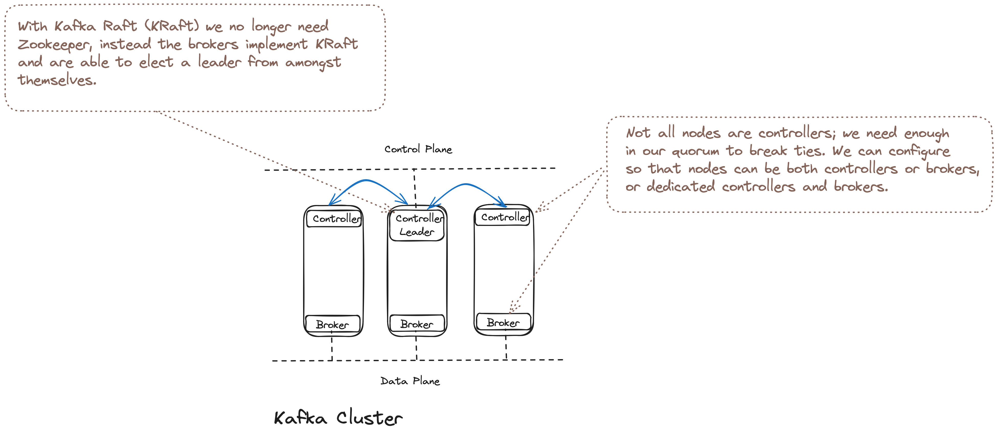

Slide 29
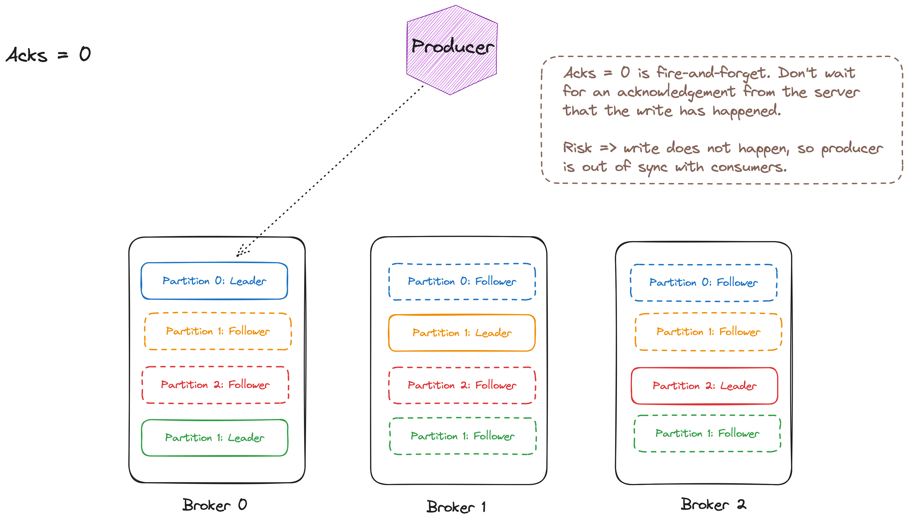

Slide 30
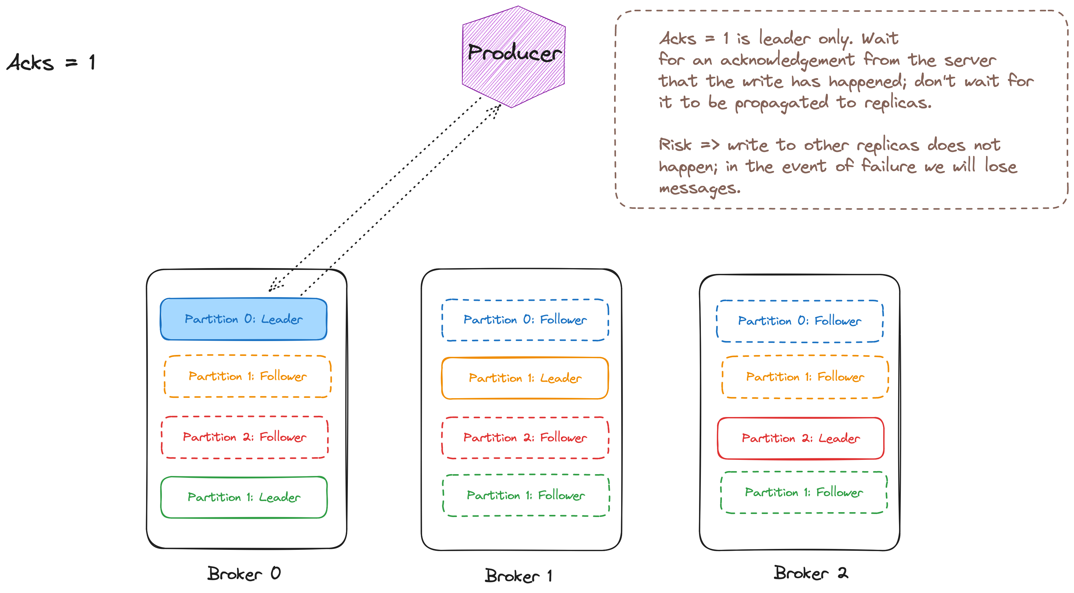

Slide 31
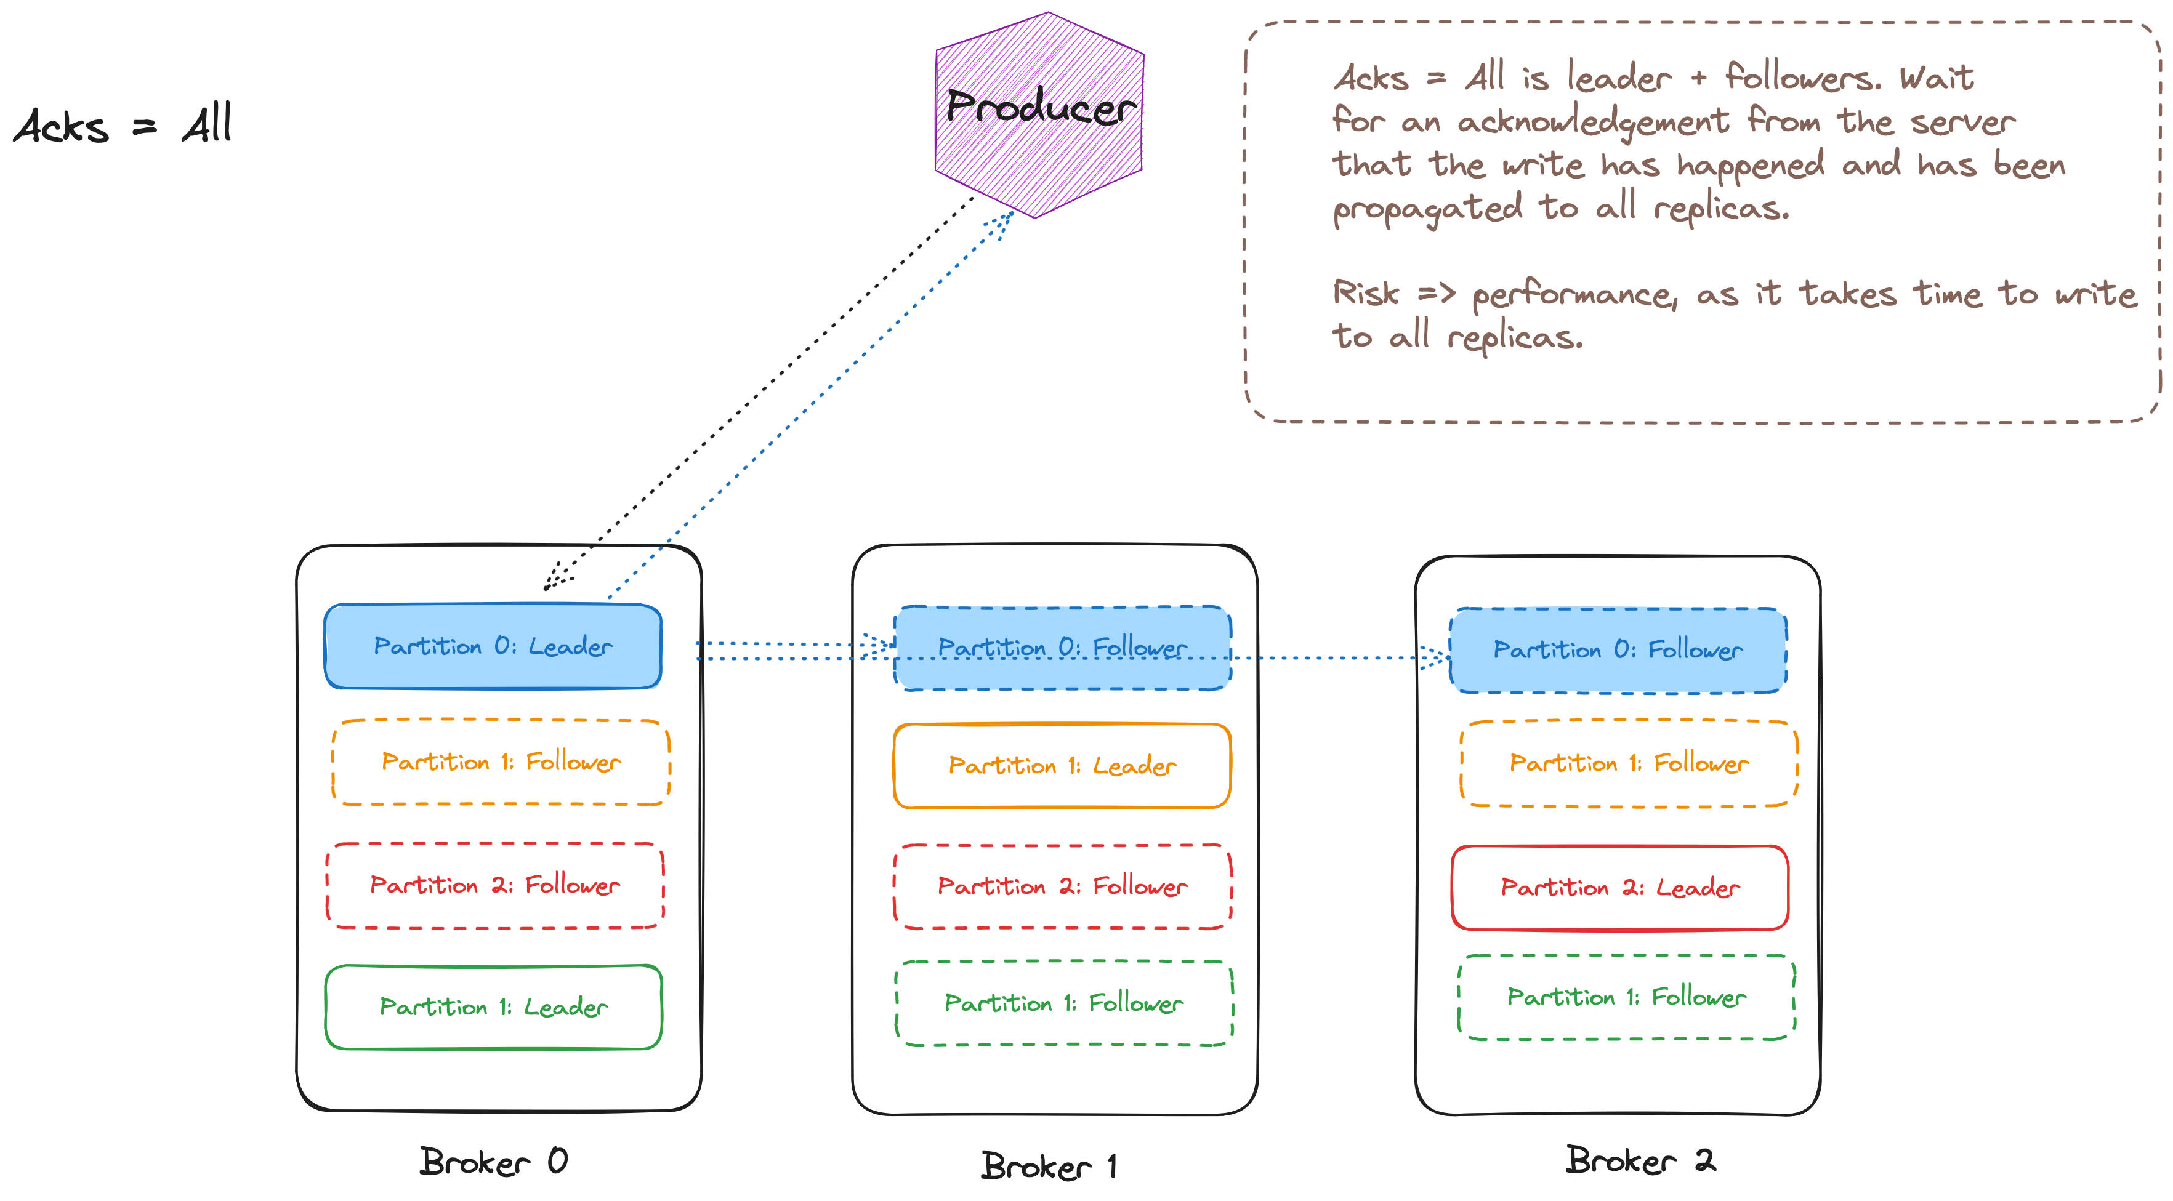

Slide 32
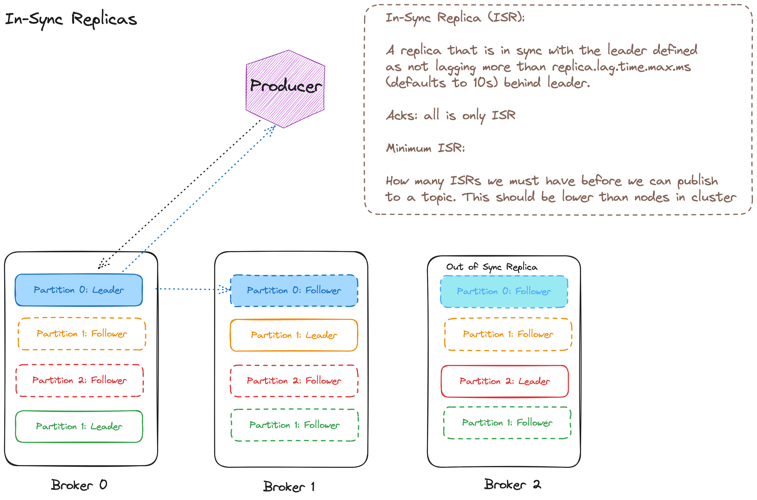

Slide 33
Agenda
T:30
Kafka
Kafka and C#
Under the Hood
Reliable Producer
Reliable Consumer
Serializers, De-serializers & Schema Registry

Slide 34
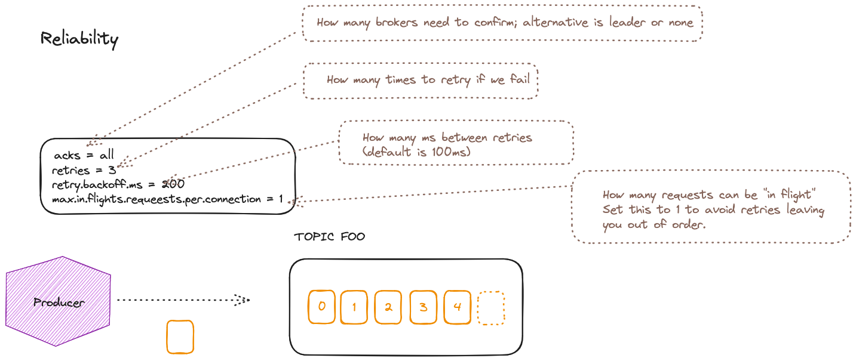

Slide 35
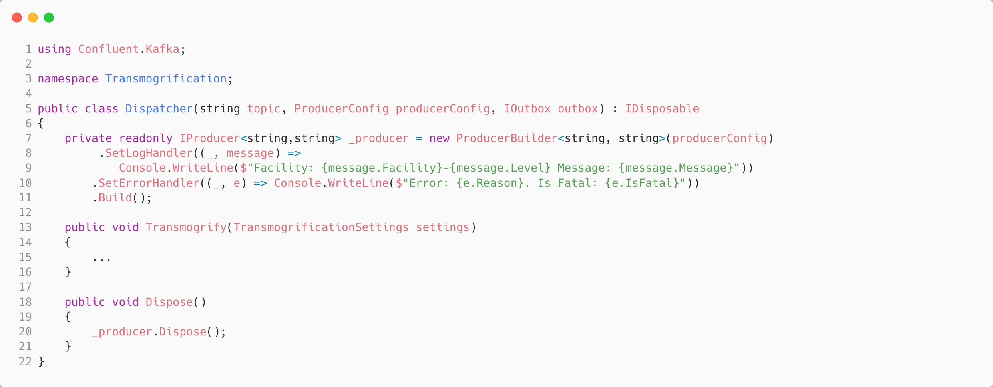
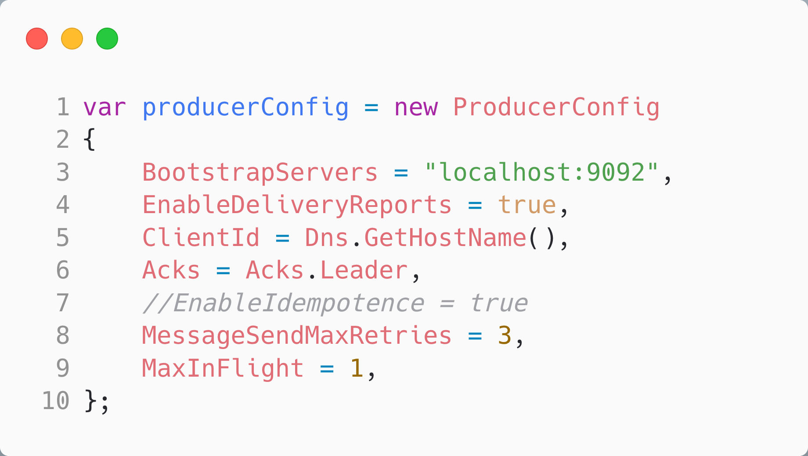
Reliably Producing a Message in C#
Configure how the SDK gives us feedback on producing messages
Notes:
//we use an outbox to be able to retry sending the message if it fails we don't show a sweeper in this example, but it would be a separate process that would periodically check the outbox for messages that haven't been persisted yet and retry sending them

Slide 36
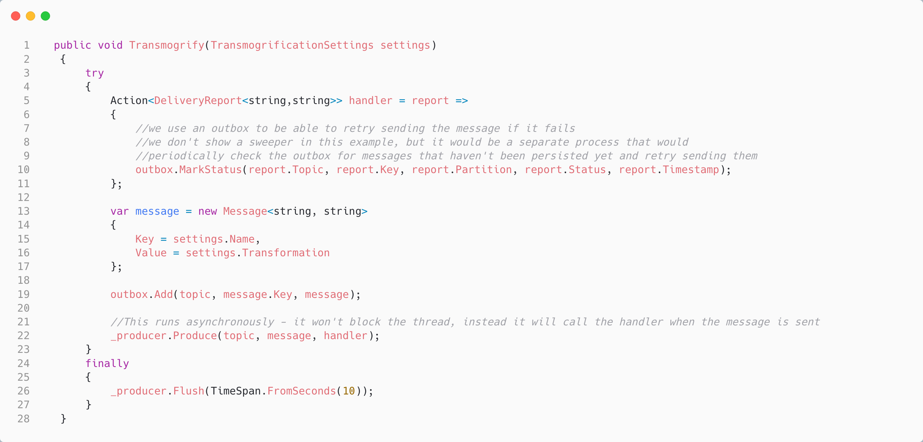
Reliably Producing a Message in C#
Mark the outbox with the status of the produce on callback
Use an “outbox” for “Transactional Messaging” [Simplified]
Don’t block on ack, instead set a callback to assess the delivery report
Notes:
//we use an outbox to be able to retry sending the message if it fails we don't show a sweeper in this example, but it would be a separate process that would periodically check the outbox for messages that haven't been persisted yet and retry sending them

Slide 37
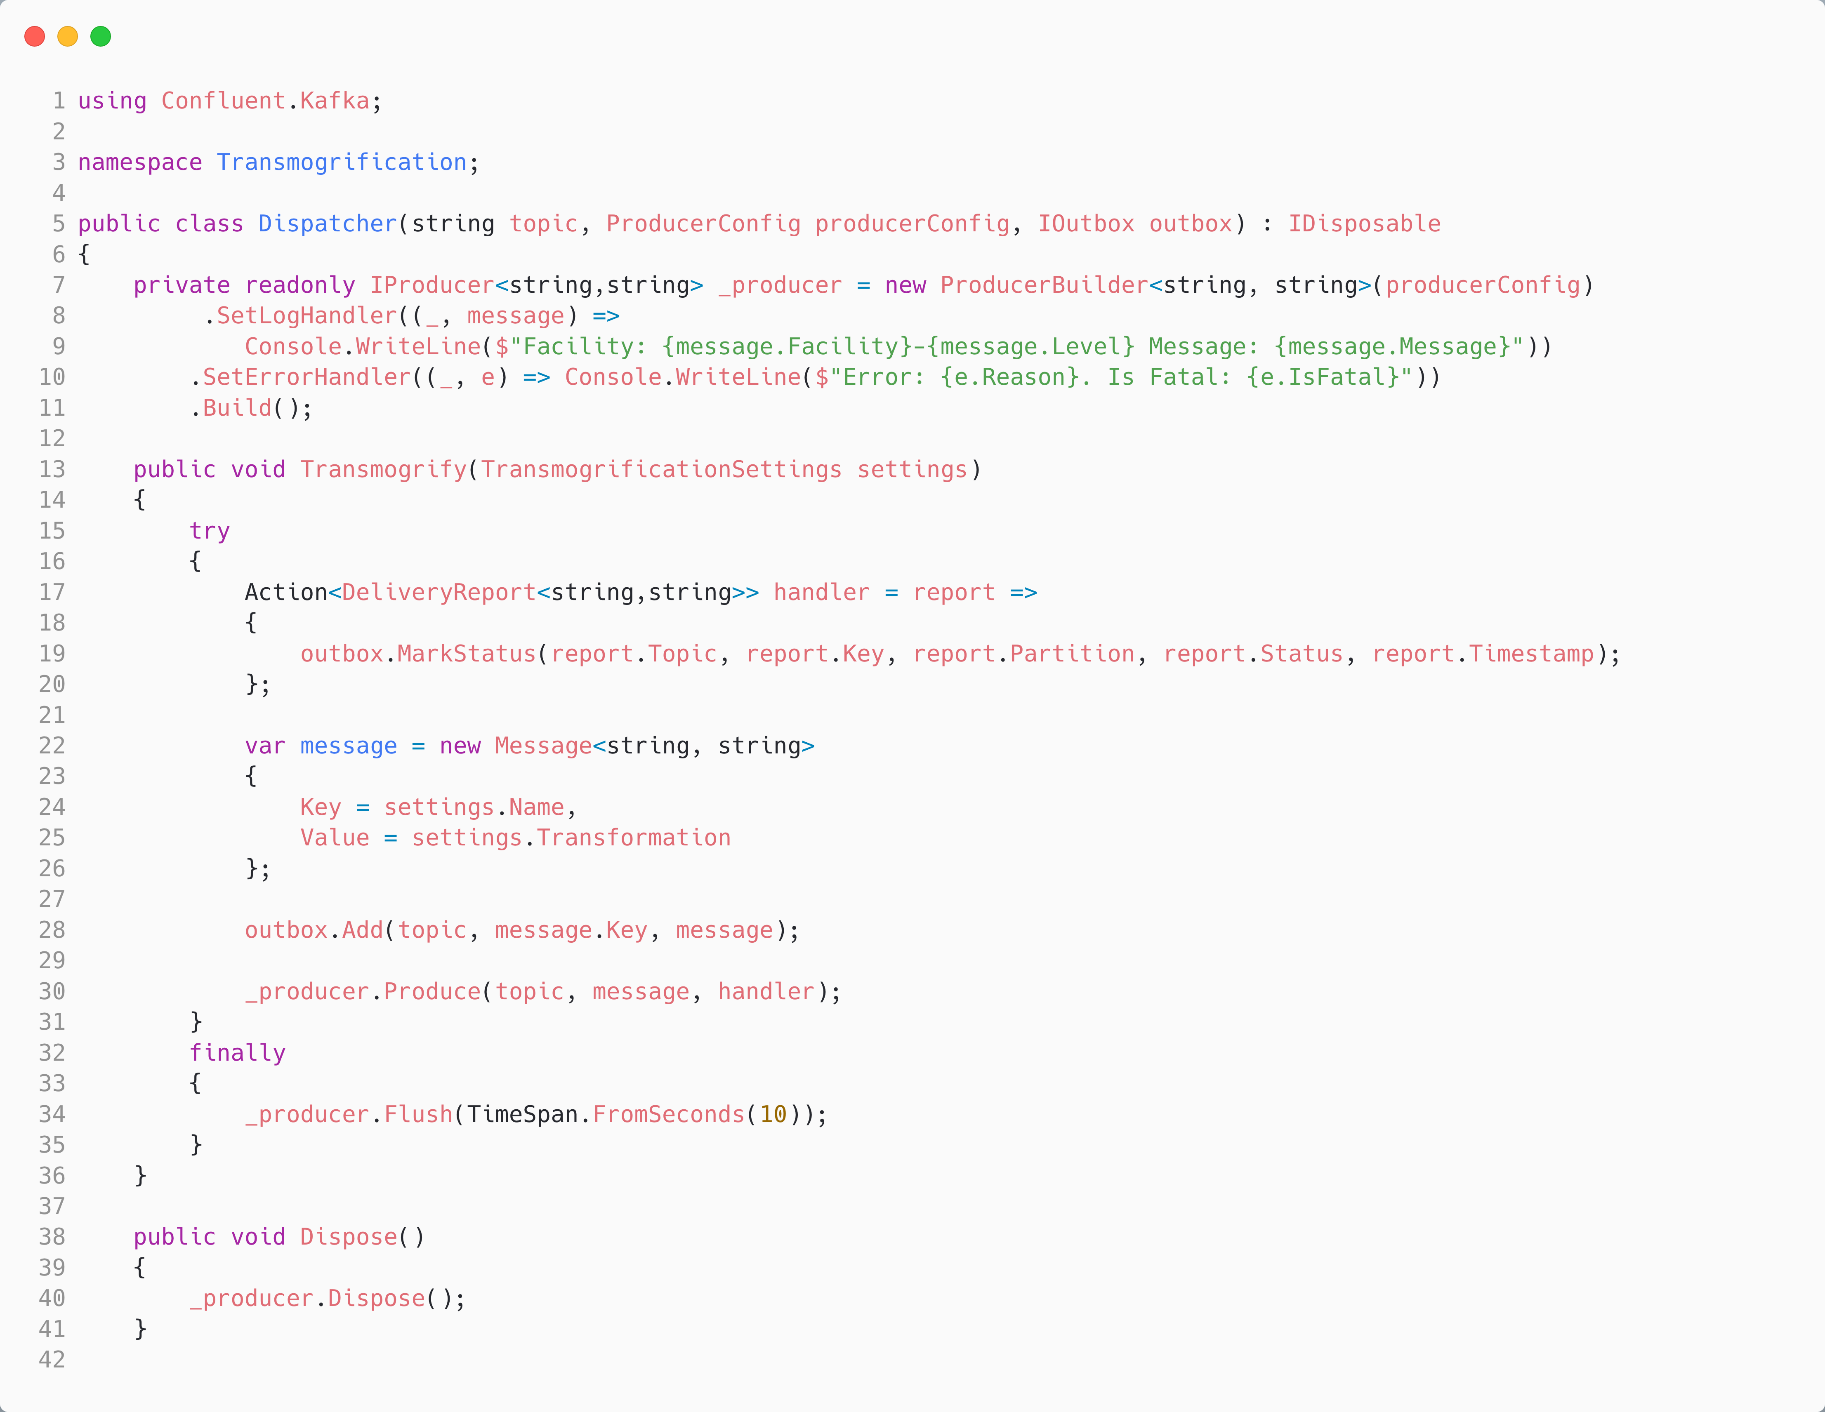
Reliably Producing a Message in C#
Configure how the SDK gives us feedback on producing messages
Mark the outbox with the status of the produce on callback
Use an outbox for Transactional Messaging
Don’t block on ack, instead set a callback to assess the delivery report
Notes:
//we use an outbox to be able to retry sending the message if it fails we don't show a sweeper in this example, but it would be a separate process that would periodically check the outbox for messages that haven't been persisted yet and retry sending them

Slide 38
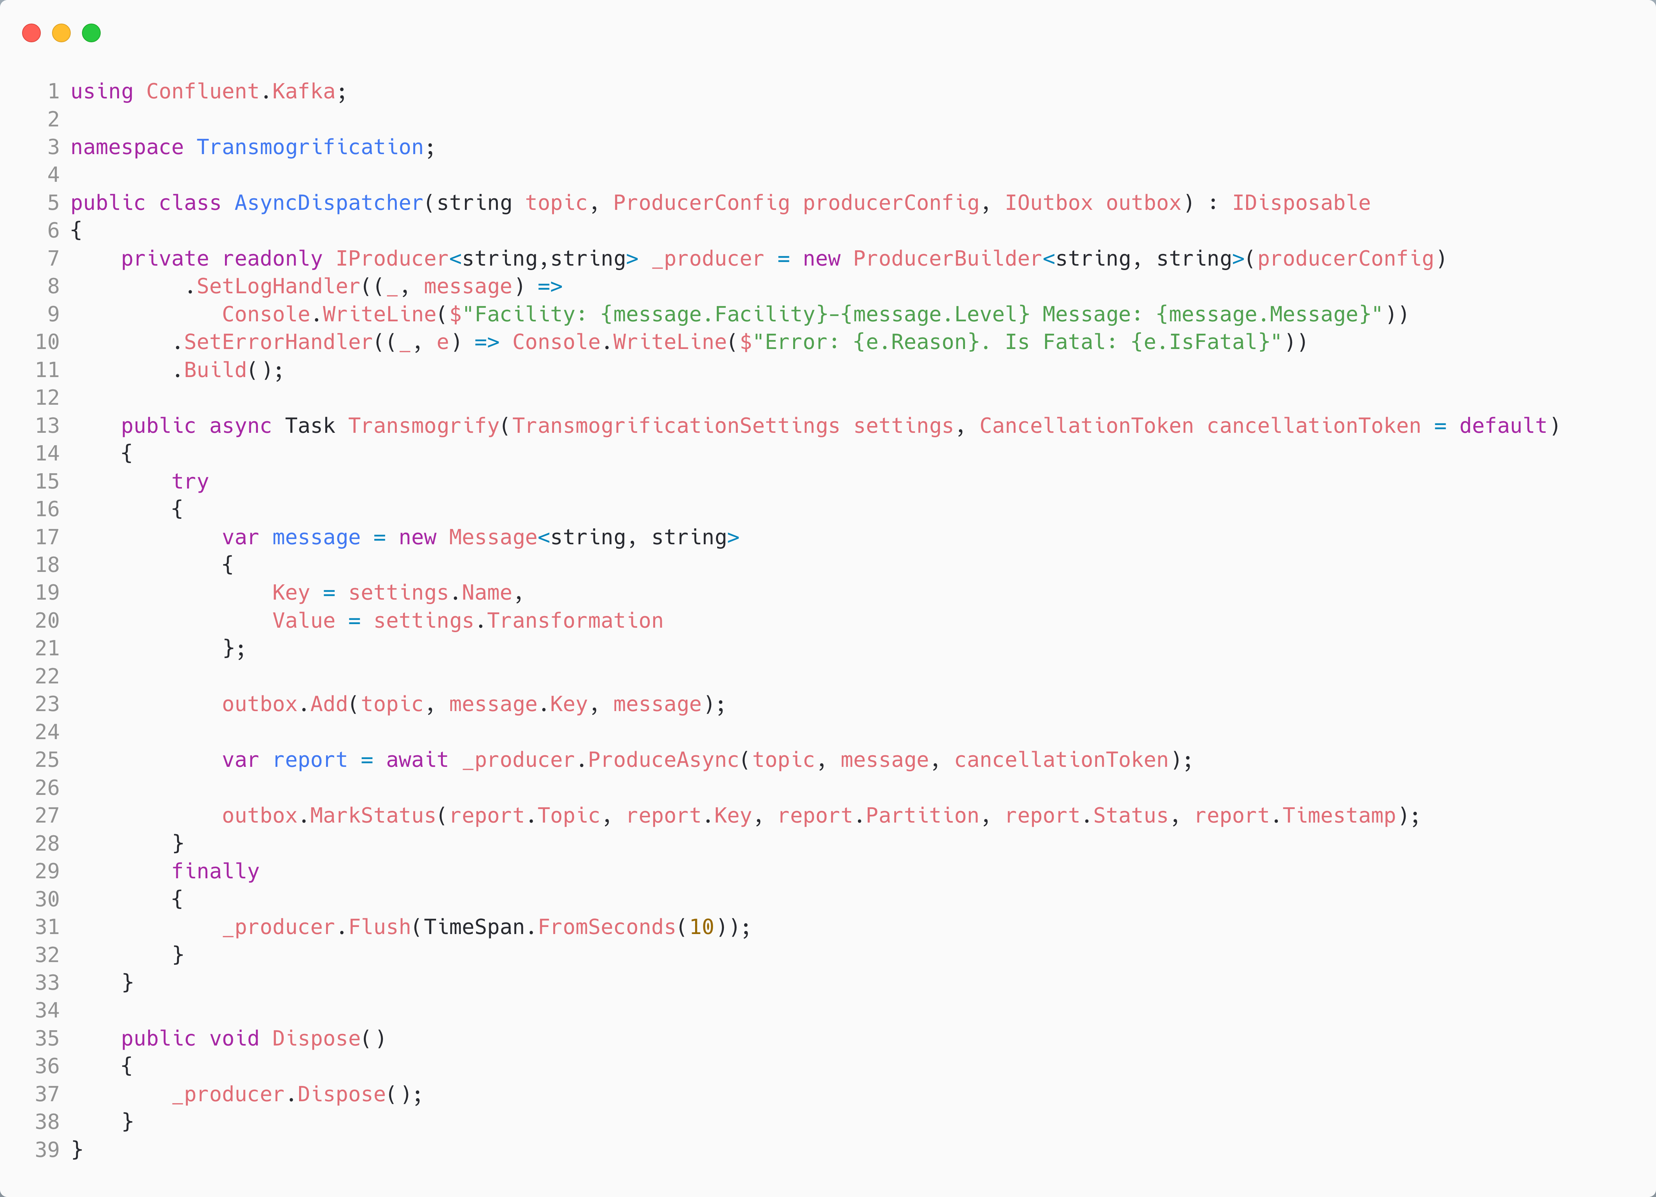
Async Reliably Producing a Message in C#
Instead of a callback using async/await for the delivery report – will not return until deliveryreport is produced, which depends on acks.
In principle, at scale, the throughput of async/await will be lower than using Produce with a callback

Slide 39
Demo Three: Reliable Producer
Calvin and Hobbes – Bill Watterson

Slide 40
Agenda
T:40
Kafka
Kafka and C#
Under the Hood
Reliable Producer
Reliable Consumer
Serializers, De-serializers & Schema Registry

Slide 41
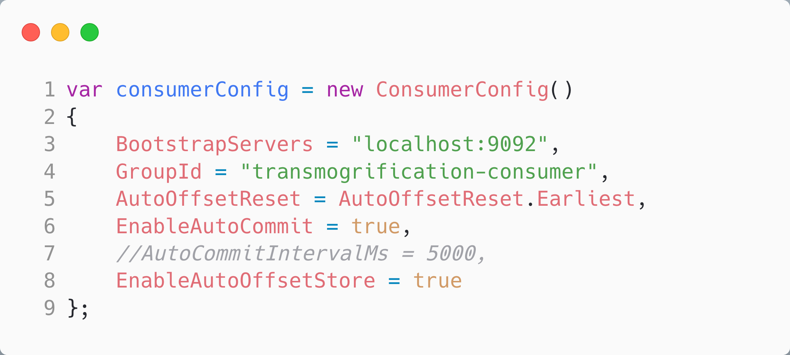
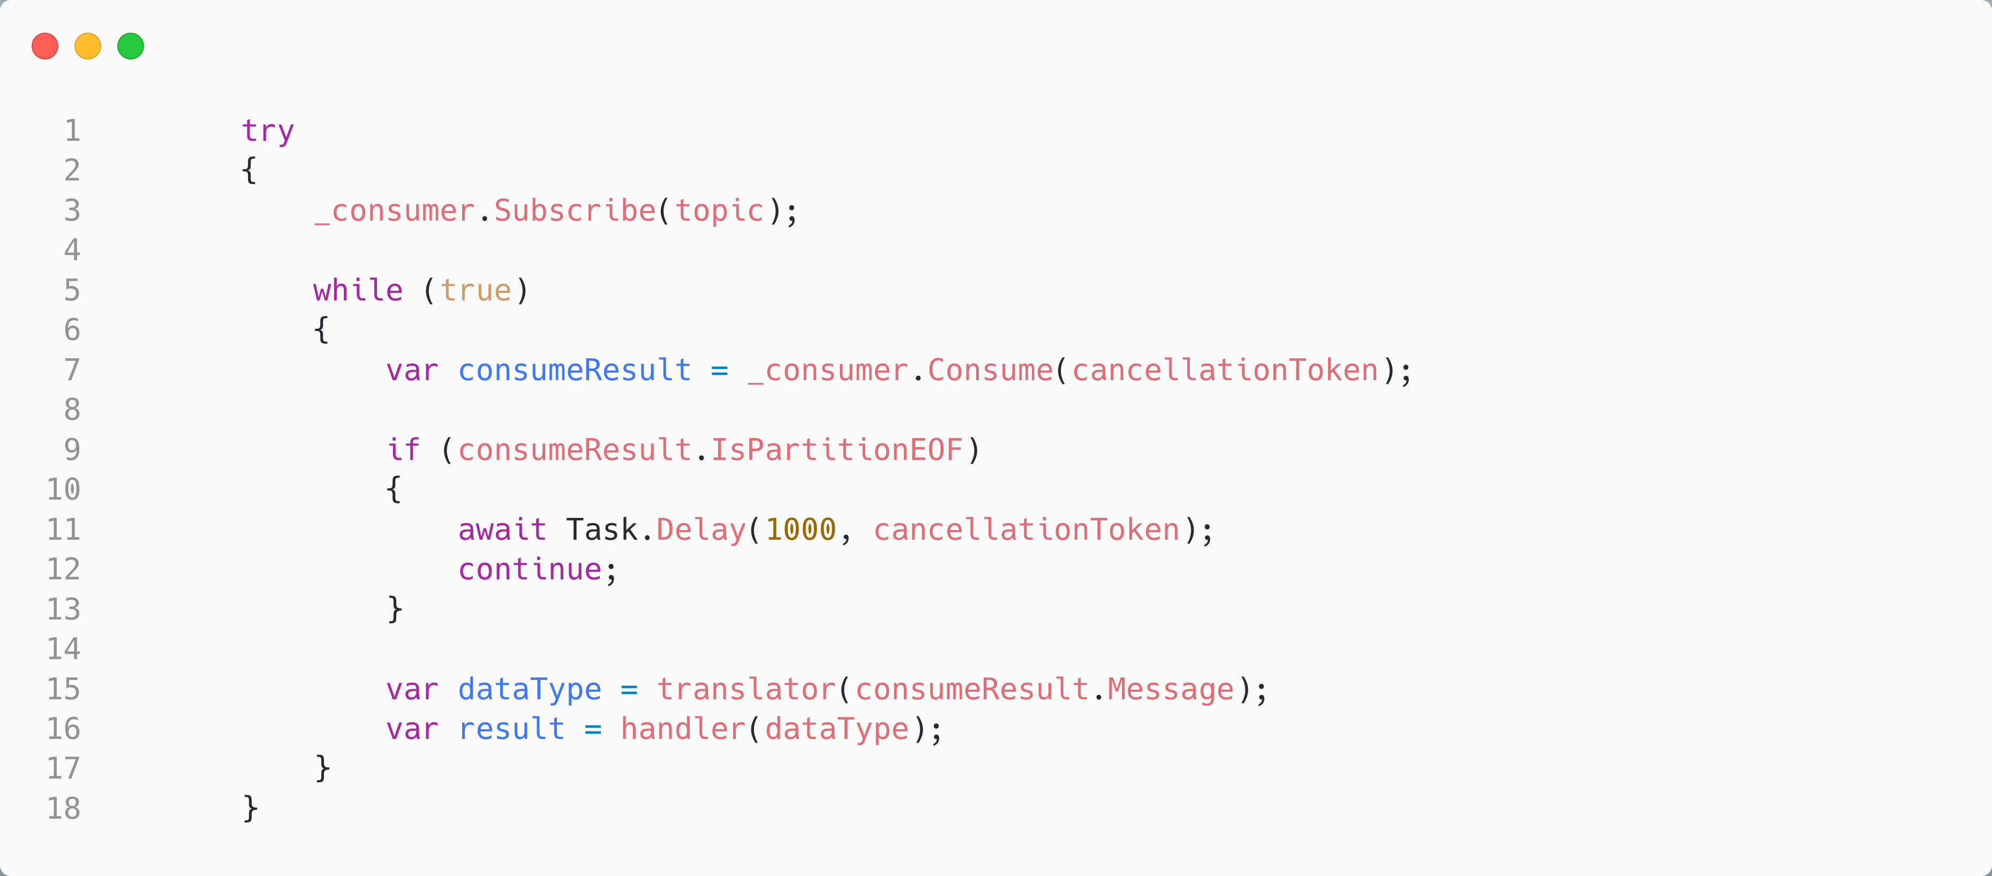
Auto Store and Commit Offsets in C#
Store the offset for a record we read, and commit it every 5s (by default)
If we fail to translate, or fail to handle the record, (including a crash) we will have committed the offset and will not re-attempt processing the record
Notes:
Automatic Commit
The easiest way to commit offsets is to allow the consumer to do it for you. If youi configure enable.auto.commit=true, then every five seconds the consumer will commit the largest offset your client received from poll(). The five-second interval
is the default and is controlled by setting auto.commit.interval.ms. Just like everything else in the consumer, the automatic commits are driven by the poll loop. Whenever you poll, the consumer checks if it is time to commit, and if it is, it will commit the offsets it returned in the last poll.

Slide 42
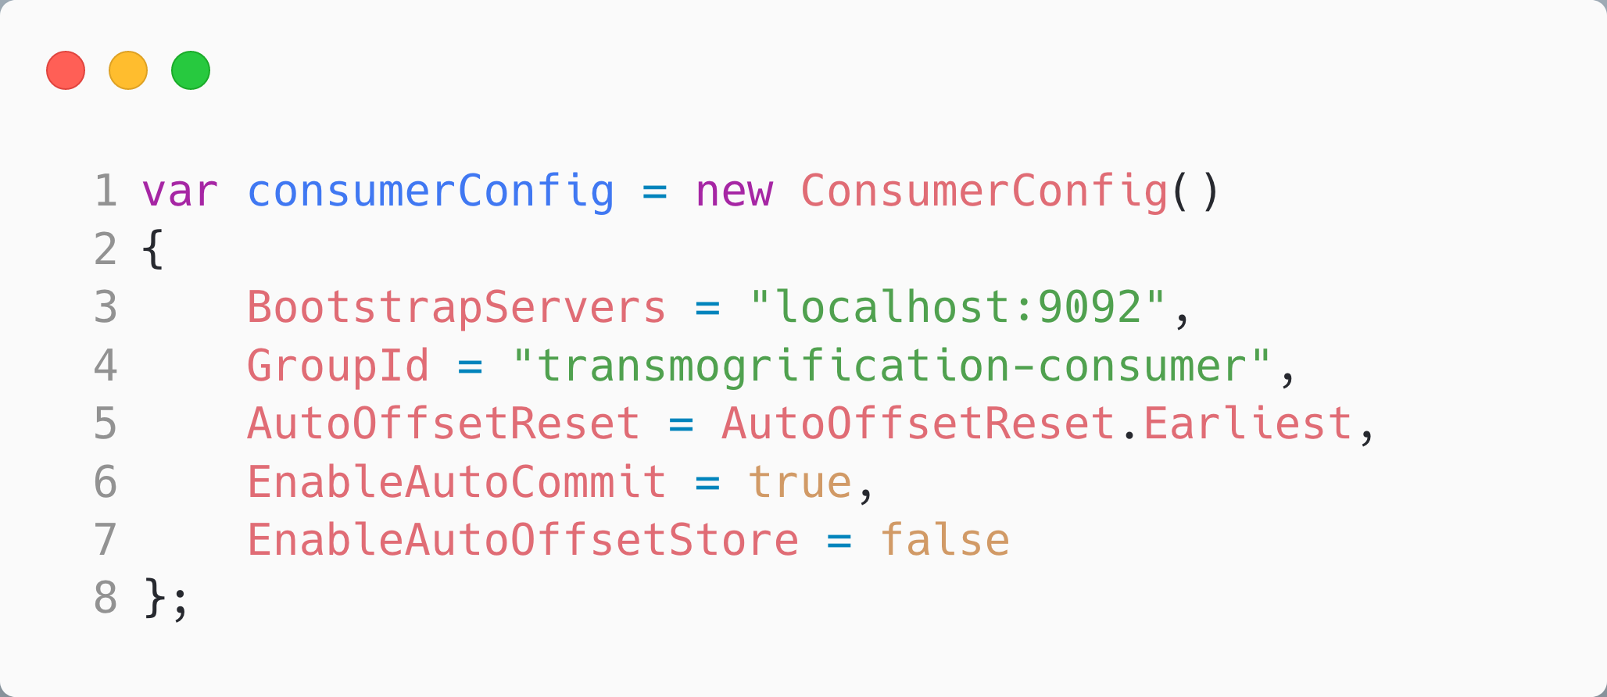
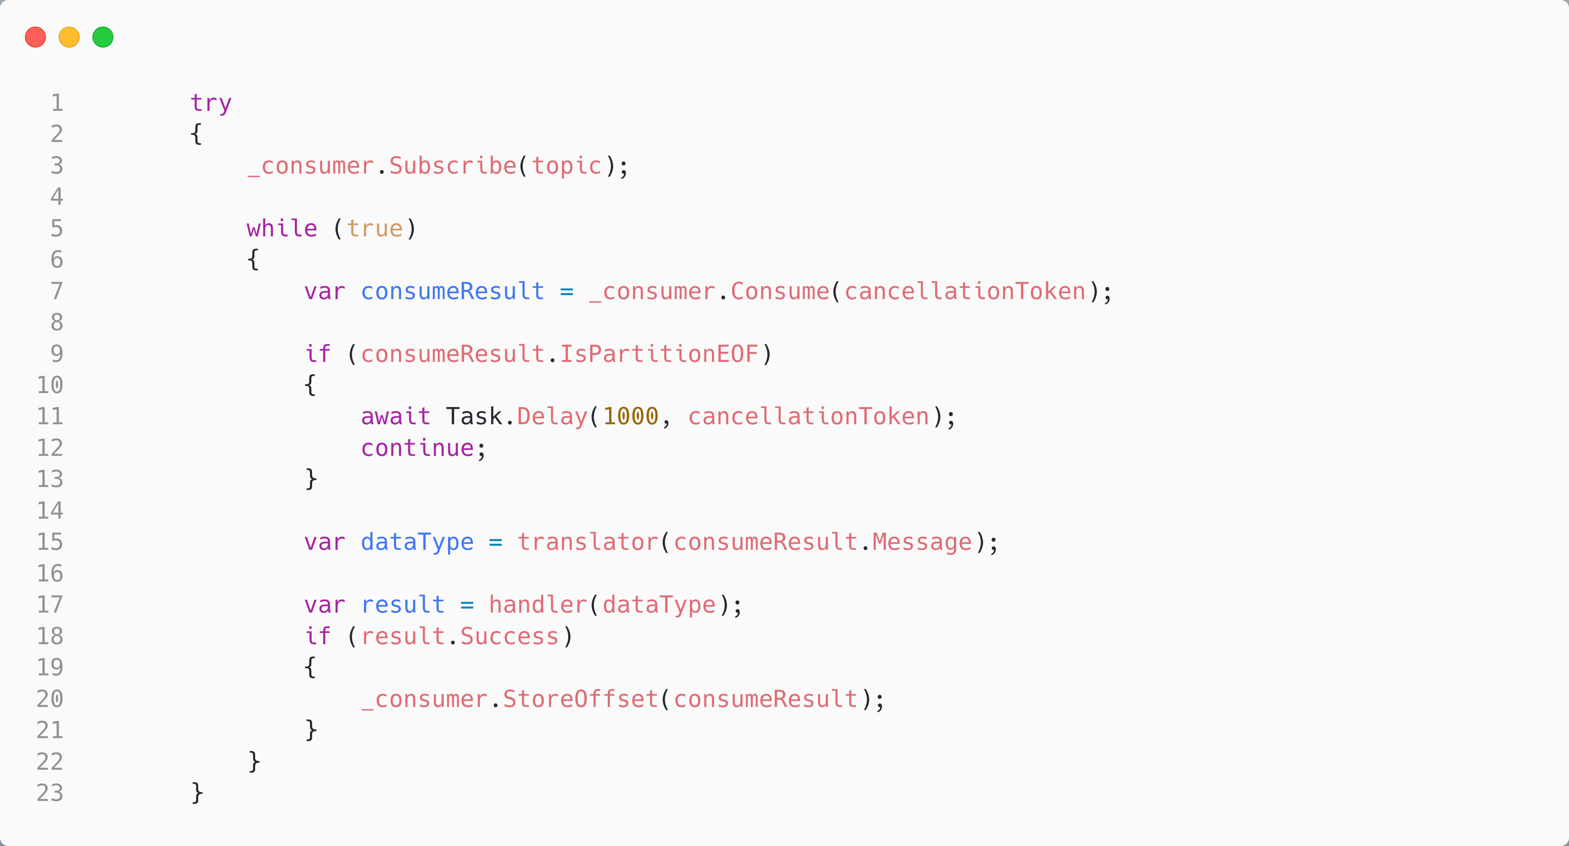
Auto Commit, Manually Store Offsets in C#
EnableAutoOffsetStore = false
Manually store offsets to the consumer’s cache; autocommit will write on a background thread
This means we only store processed records (every 5s)

Slide 43
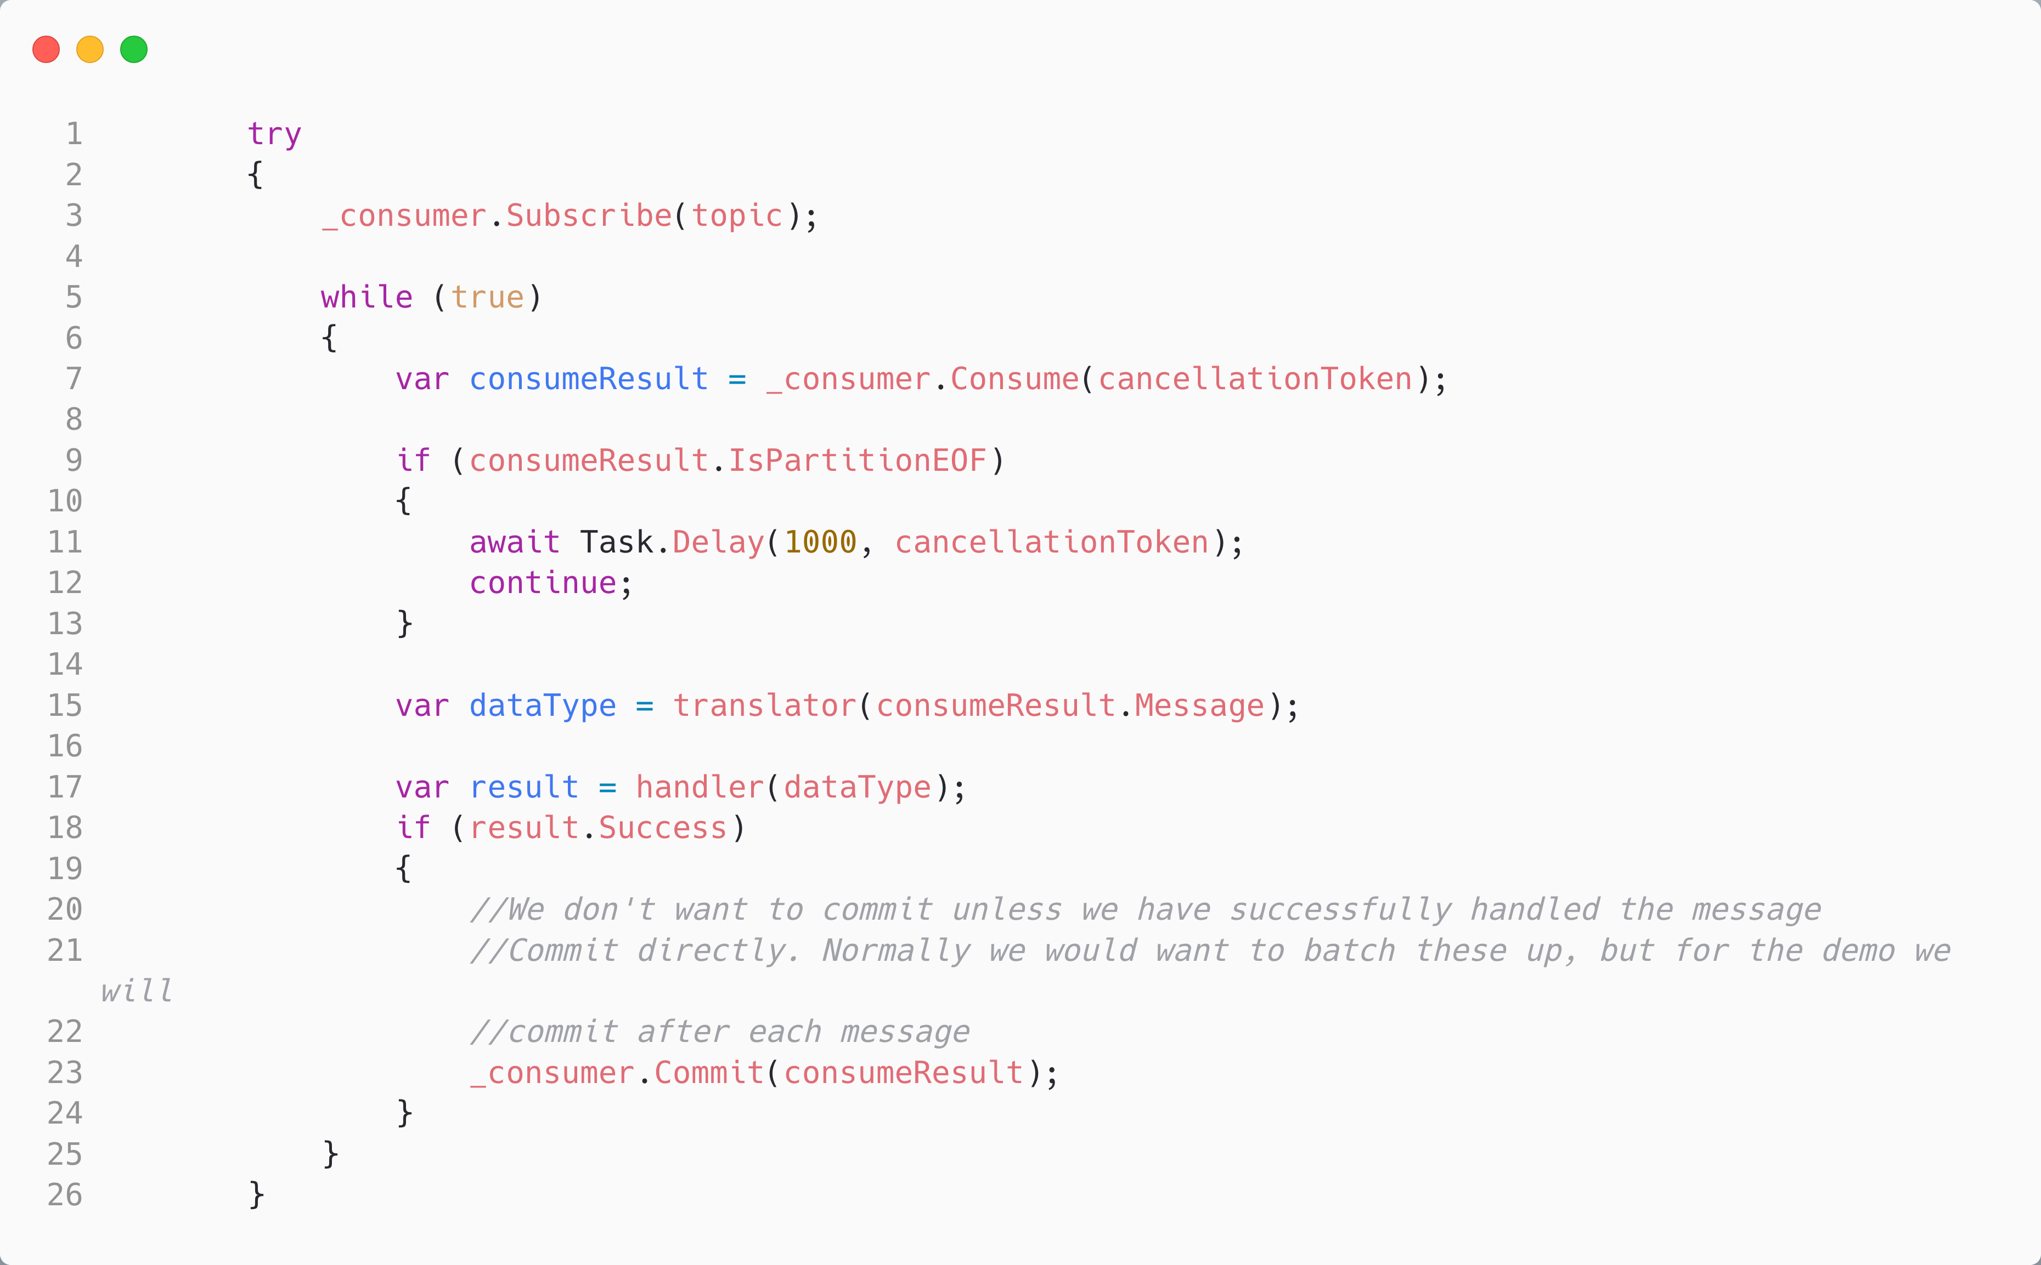
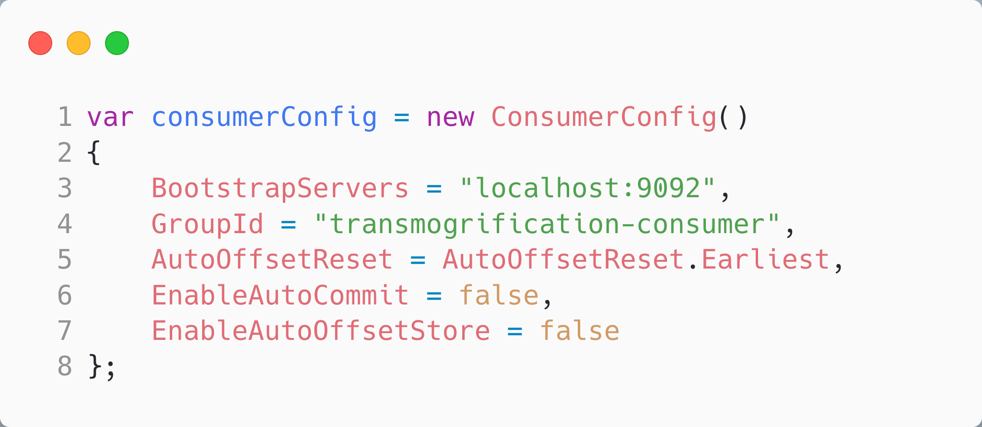
Manually Commit, Manually Store Offsets in C#
EnableAutoOffsetStore = false
EnableAutoCommit = false
We choose to manually store the commits
Manually store commits with:
_consumer.Commit(consumeResult)

Slide 44
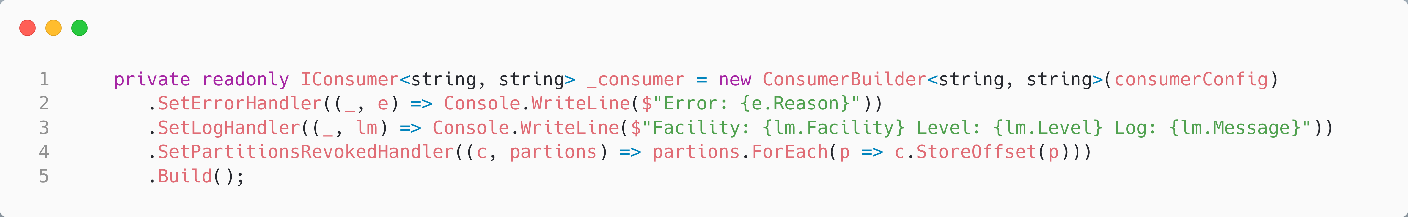
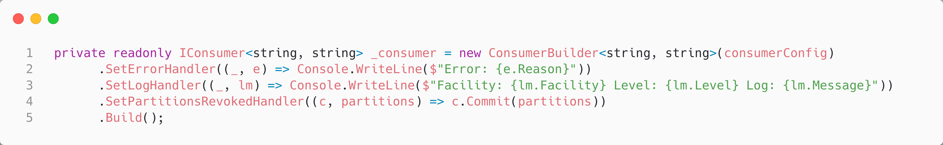
Partition Revoke and Offsets in C#
Our strategy when a partition is revoked (a new consumer joins the group) must match the strategy we use when we have that partition, and ensure outstanding offsets will be committed.

Slide 45
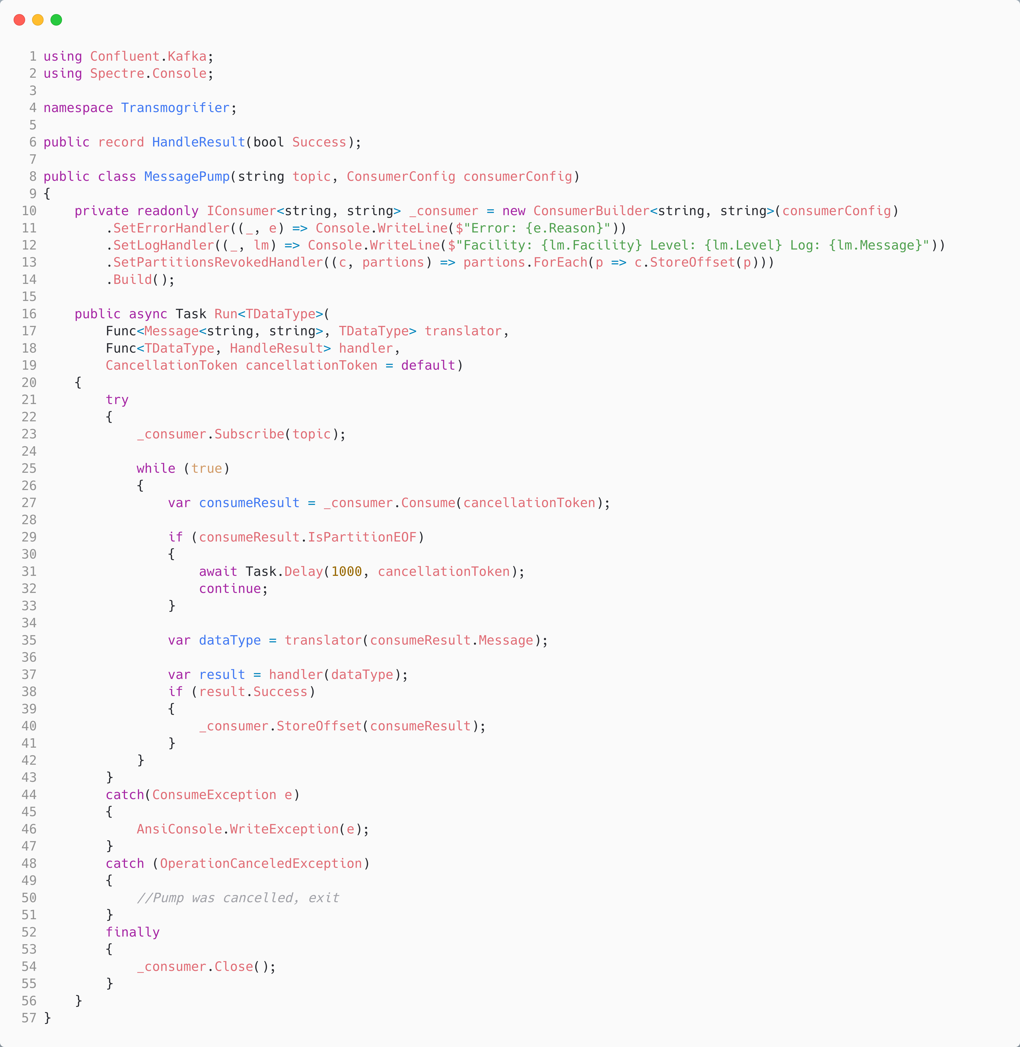
Demo Five: Reliably Consume A Message
Calvin and Hobbes – Bill Watterson

Slide 46
Agenda
T:50
Kafka
Kafka and C#
Under the Hood
Reliable Producer
Reliable Consumer
Serializers, De-serializers & Schema Registry

Slide 47
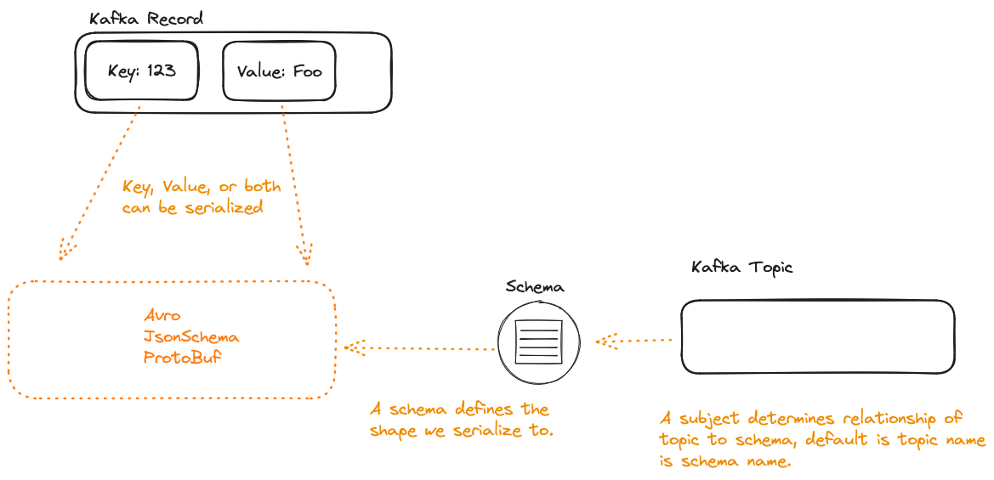

Slide 48
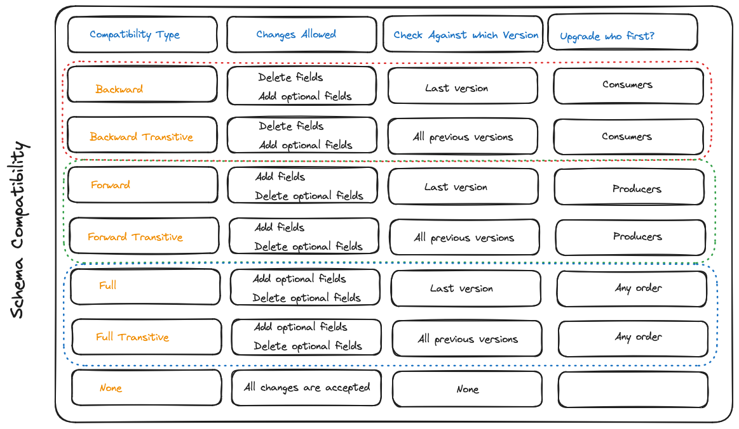
Consumers using the new version can read messages with the last version
Producers using the new version can send messages to consumers with the last version
Producers and consumers may be on the last version and still communicate

Slide 49
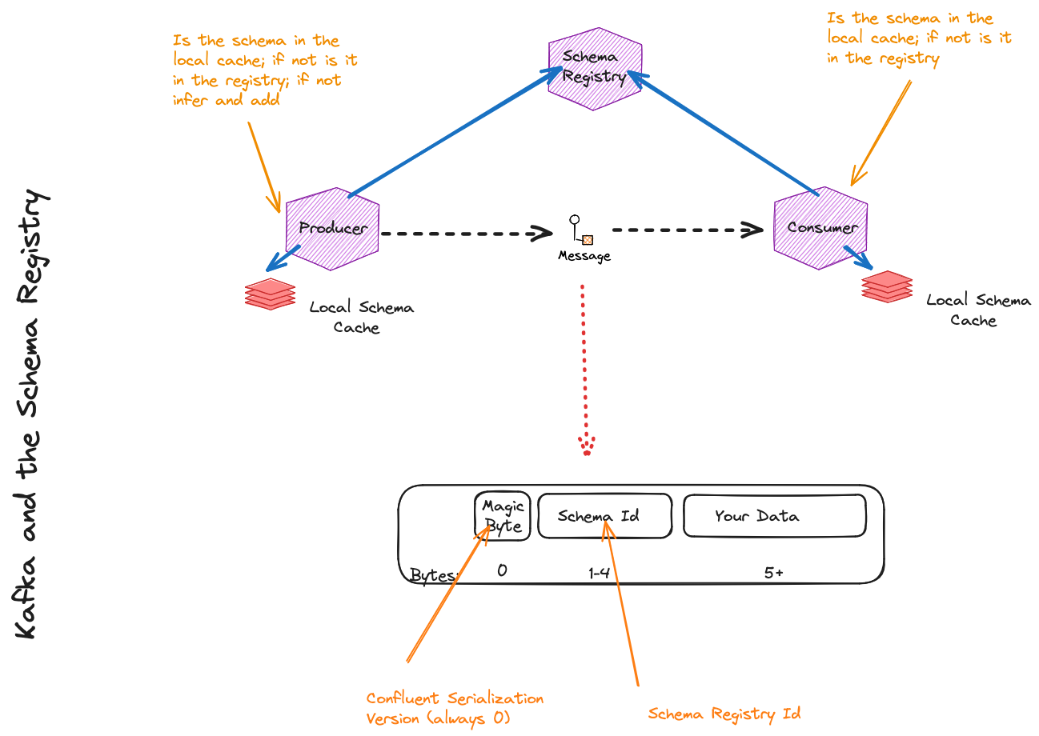
Notes:
Worth noting, consider the value as bytes, even if you have serialized JSON

Slide 50
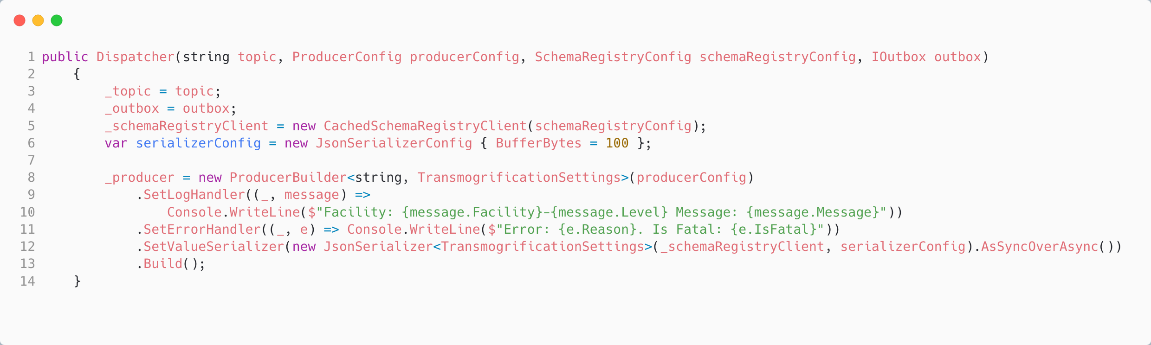
Producing with a Schema Registry in C#
We need to pass in a configuration for the
Schema registry
We use the Confluent Serdes Serializer that passes in the schema registry. It will register our schema if none exists; unless we configure it not to (recommended in production).
Note that it uses NJSonSchema for markup and Newtonsoft for JSON serialization, under the hood
Notes:
Also worth noting that because when we use a non async Produce method, it will expect a sync value serializer and vice-versa.

Slide 51
Demo Six: Schema Registry in C#
Calvin and Hobbes – Bill Watterson

Slide 52
Agenda
Kafka
Kafka and C#
Under the Hood
Reliable Producer
Reliable Consumer
Serializers, De-serializers & Schema Registry

Slide 53
Links
The Sample Code: https://github.com/iancooper/KafkaForDotNetDevs
Brighter: https://github.com/BrighterCommand/Brighter
This Presentation: https://github.com/iancooper/Presentations
Other Topics
Kafka Connect: Turn a data source into a Kafka stream and vice versa
KSQL: Run queries on Kafka Streams
Streams Applications: Run queries on Kafka Streams in Code (C# Community Support only)
Alternatives to Connect: Flink, Benthos, etc

